Slide 1




राष्ट्रीय अनुभव पुरस्कार
NATIONAL ANUBHAV AWARDS

Slide 2

INDEX
S.No. | ITEMS | PAGES
1. | Invitation | 1-2
2. | Introduction to Anubhav Portal | 3-4
3. | Overview of National Anubhav Awards Scheme, 2026 (Flyer) | 5-10
4. | National Anubhav Awards Scheme, 2026 | 11-15

Slide 3
INVITATION
1

Slide 4


Ministry of Personnel, Public Grievances & Pensions
Department of Pension & Pensioners' Welfare
Warmly Solicits
….Name with Designation…..
To share his rich and varied experiences, while serving the Nation in various capacities on
Anubhav Portal
Under the aegis of
National Anubhav Awards Scheme, 2026
For more details, please scan the QR code
2

Slide 5
INTRODUCTION
TO
ANUBHAV PORTAL
3

Slide 6
The Anubhav Portal was launched by the Department of Pension and Pensioners’ Welfare at the behest of our visionary Prime Minister in March, 2015 to provide an online system to the retiring and retired employees for showcasing their commendable work during service. Their experiences of working in the Government and their suggestions in these write ups provide an opportunity for improvement in governance.
The portal has celebrated its illustrious 10 years in 2025 with more than 12,500 write-ups published on the portal, showing the growing role of this portal. Till 2025, 64 Anubhav Awards and 29 Anubhav Jury Awards have been conferred in 8 ceremonies.
In recent years, several initiatives have been undertaken to realize the objectives behind the portal. In 2022, Anubhav Awardees’ Speak, a webinar series was introduced, wherein the Awardees address the soon-to-be-retiring employees and share their experiences and also encourage them for participation in the scheme. In 2023, 10 Anubhav Jury Awards, apart from 05 Anubhav Awards were introduced to ensure wider participation. Also, specific number of awards were assigned to the three pay scale groups to ensure participation even from lower rung officials. In 2024, parameter specific marking system was introduced for bringing objectivity in the assessment process and employees of 12 Public Sector Banks and Central Public Sector Enterprises were also included in the scheme for an increased participation. In 2025, specific marks to the ‘feedback/suggestions’ have been assigned in the marking system.
4

Slide 7
OVERVIEW OF NATIONAL
ANUBHAV AWARDS SCHEME, 2026
FLYER
5

Slide 8
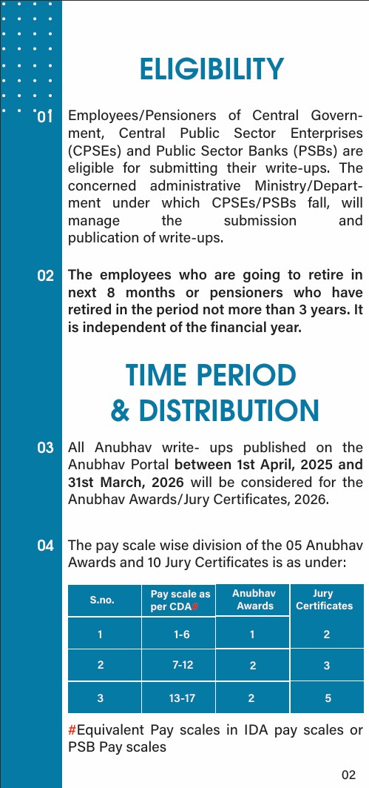
6

Slide 9
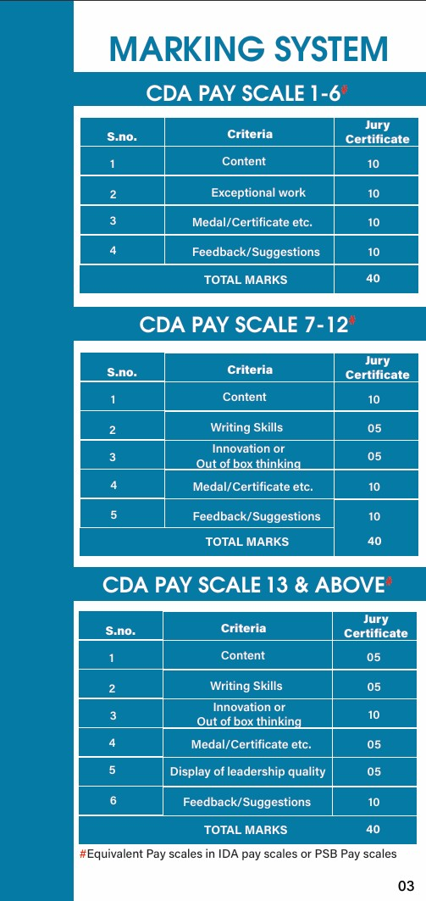
7

Slide 10
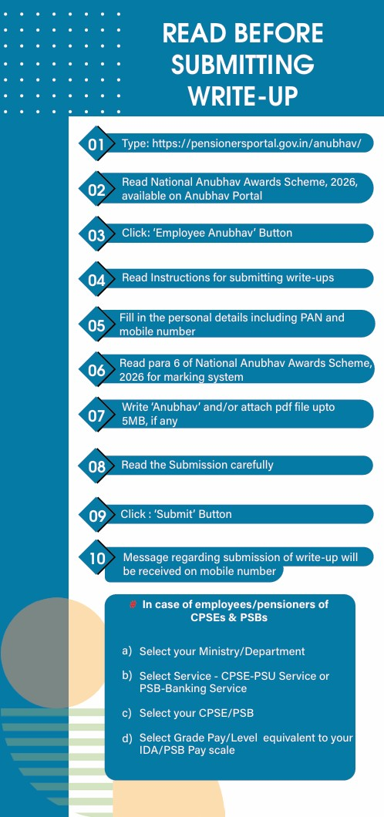
Pay Scale.
8

Slide 11
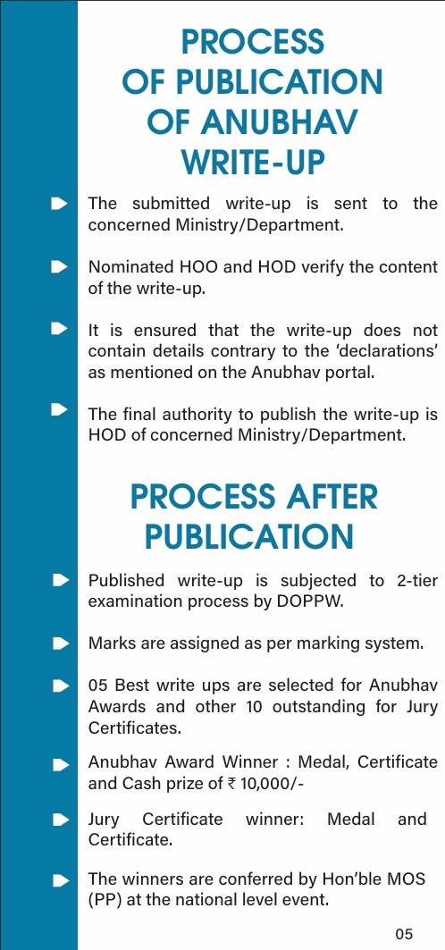
9

Slide 12

10

Slide 13
NATIONAL
ANUBHAV
AWARDS
SCHEME, 2026
11

Slide 14

12

Slide 15

13

Slide 16
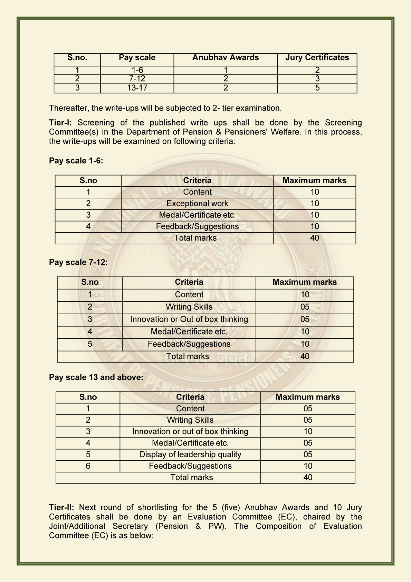
14

Slide 17

15

Slide 18
NOTES
.....................................................................................................................
.....................................................................................................................
.....................................................................................................................
.....................................................................................................................
.....................................................................................................................
.....................................................................................................................
.....................................................................................................................
.....................................................................................................................
.....................................................................................................................
.....................................................................................................................
.....................................................................................................................
.....................................................................................................................
.....................................................................................................................
.....................................................................................................................
.....................................................................................................................
.....................................................................................................................
.....................................................................................................................
.....................................................................................................................
.....................................................................................................................

Slide 19
NOTES
.....................................................................................................................
.....................................................................................................................
.....................................................................................................................
.....................................................................................................................
.....................................................................................................................
.....................................................................................................................
.....................................................................................................................
.....................................................................................................................
.....................................................................................................................
.....................................................................................................................
.....................................................................................................................
.....................................................................................................................
.....................................................................................................................
.....................................................................................................................
.....................................................................................................................
.....................................................................................................................
.....................................................................................................................
.....................................................................................................................
.....................................................................................................................

Slide 20



Address - 3rd Floor, B Wing, Lok Nayak Bhawan,
Khan Market, New Delhi-110003
Phone - (011)24654734
Email – care.dppw@nic.in

