Slide 1

e-Pass System
Centre for Railway Information Systems

Slide 2
4-Step Operation(Pass Admin)
Access Authorisation
Updating Legacy Data
Online Issuance of Pass
1
2
3
Unit Admin creates Pass Admins
Pass Admin
Create Pass Issuing Authority (PIA) and Pass Clerk (PC)
Give Access Authorisation to Pass Clerk
Tagging Pass Clerks to PIA
Tagging Employees to PIA
Recoding of details of Pass issued Manually by Pass Clerk
Verification of recorded Manual Pass by Employee
Update Employee’s Family Details
Acceptance of Family Details
Apply for Privilege Pass/ PTO
Accept Pass Application
Issue of Privilege Pass/ PTO
Split Pass Application
Cancellation Request

Slide 3
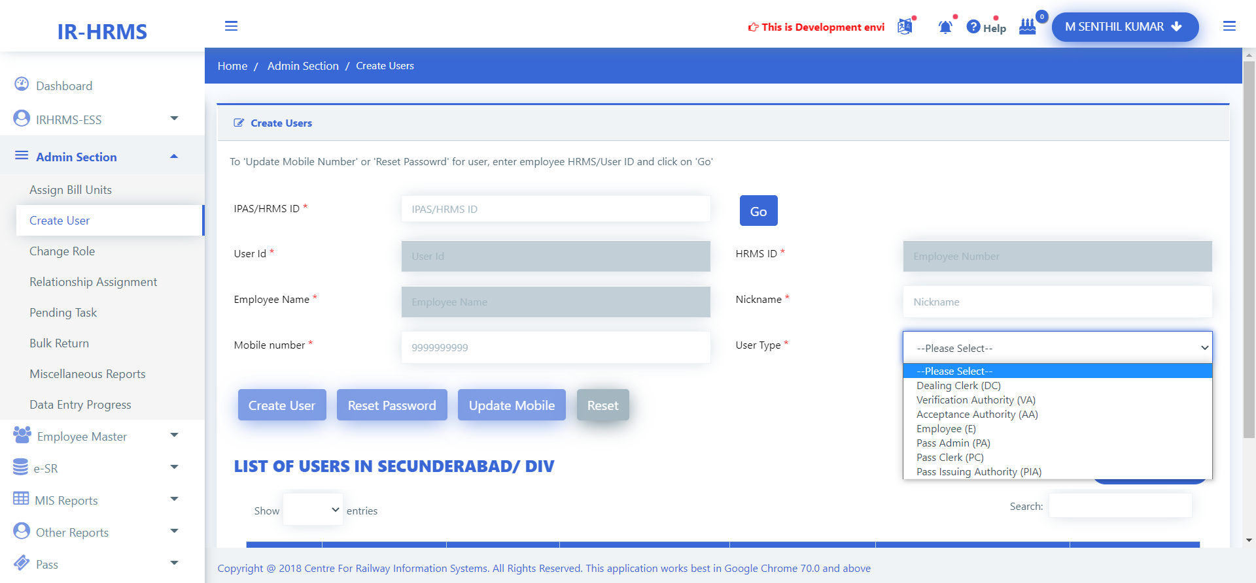
Creating Pass Admins

Slide 4







Access Authorisation by Pass Admin
Provide Access Authorisation to Pass Issuing Authorities one by one
Pass Issuing Authority
Pass Issuing Authority
Provide Access Authorisation to Pass Clerks one by one
Pass Clerk
Pass Clerk
Tag Pass Clerks to their respective Pass Issuing Authority
Tag Individual Employee to her/ his respective Pass Issuing Authority
Group of Employees may also be tagged to their PIA
Employees
Employees

Slide 5
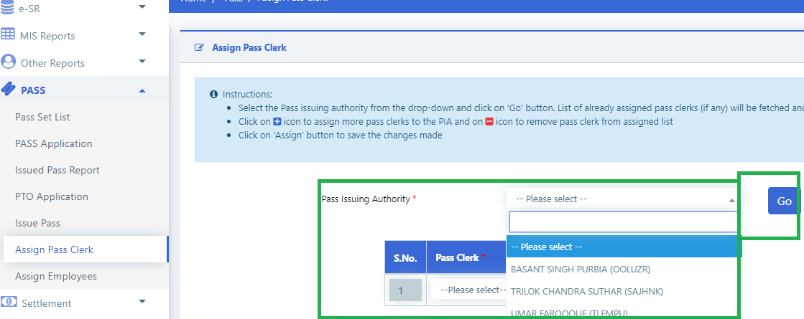
Create User and Assign Role

Slide 6
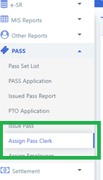
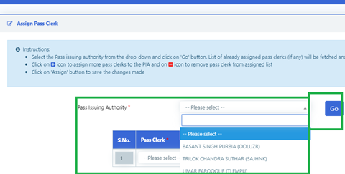
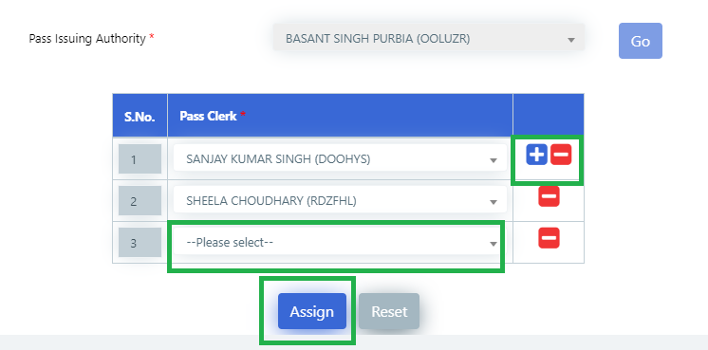
Tagging Pass Clerks to their PIA

Slide 7
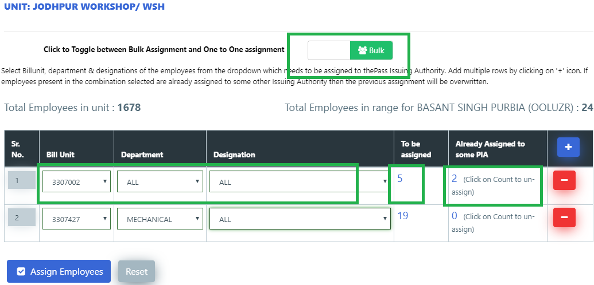
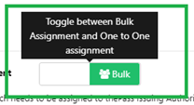
Tag Group of Employees to their PIA

Slide 8
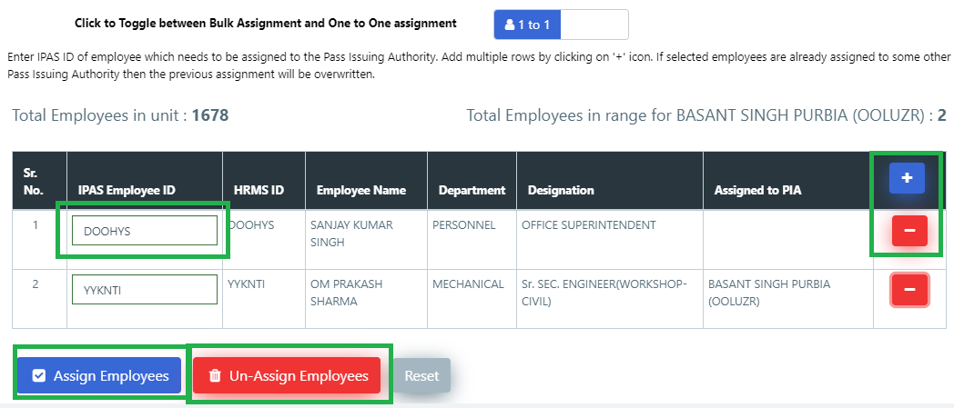
Tag Individual Employee to PIA

Slide 9

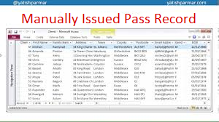






Updating Legacy Data
Pass Clerk enters past Pass-Records into the E-Pass System
Employee accepts the recorded past Pass-Records if found correct
Pass Clerk
Employee
Employee returns the recorded past Pass-Records if found erroneous
Manual Pass-Records
Recorded Pass-Records
Family details of employee is retrieved from HRMS database
Employee updates/ confirms her/ his dependant family members
Pass Clerk
Employee
Pass Clerk accepts revised Family details of employee
HRMS Database
Employee’s Family Detail

Slide 10
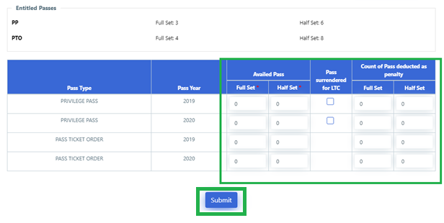
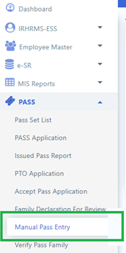
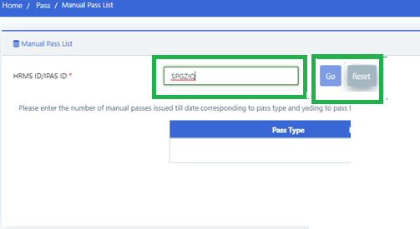
Recording Manual Pass by Pass Clerk
Privilege Ticket Order
Privilege Ticket Order

Slide 11
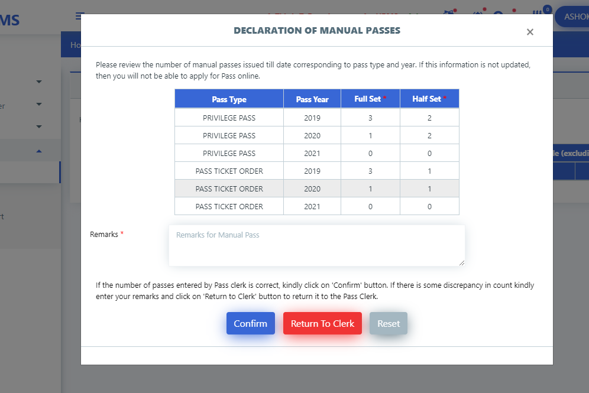
Verification of Recorded Pass by Employee
Privilege Ticket Order
Privilege Ticket Order
Privilege Ticket Order

Slide 12
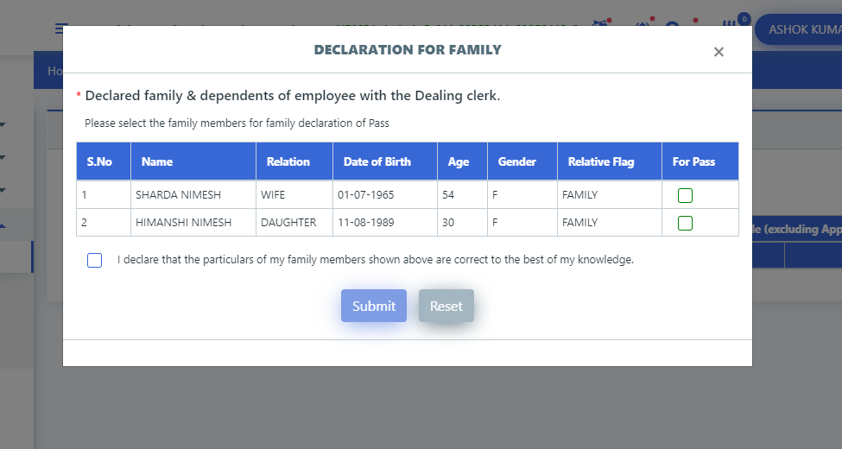
Declaration of Dependent in Family

Slide 13
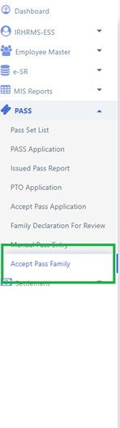
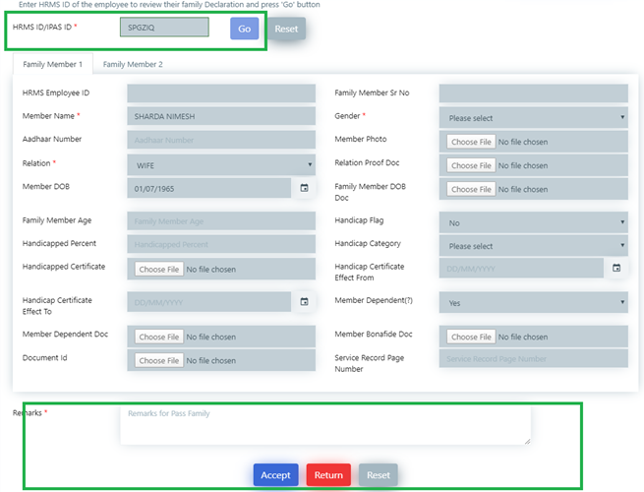
Acceptance of Family Details of the Employee

Slide 14
Issuance of Privilege Pass/PTO & Split Pass
Employee
Pass Clerk
PIA
Submits Application for Pass
Accepts the Application
Issues Privilege Pass Online
Employee
Pass Clerk
PIA
Submits Application for Split Pass
Accepts the Application
Issues Split Pass Online

Slide 15
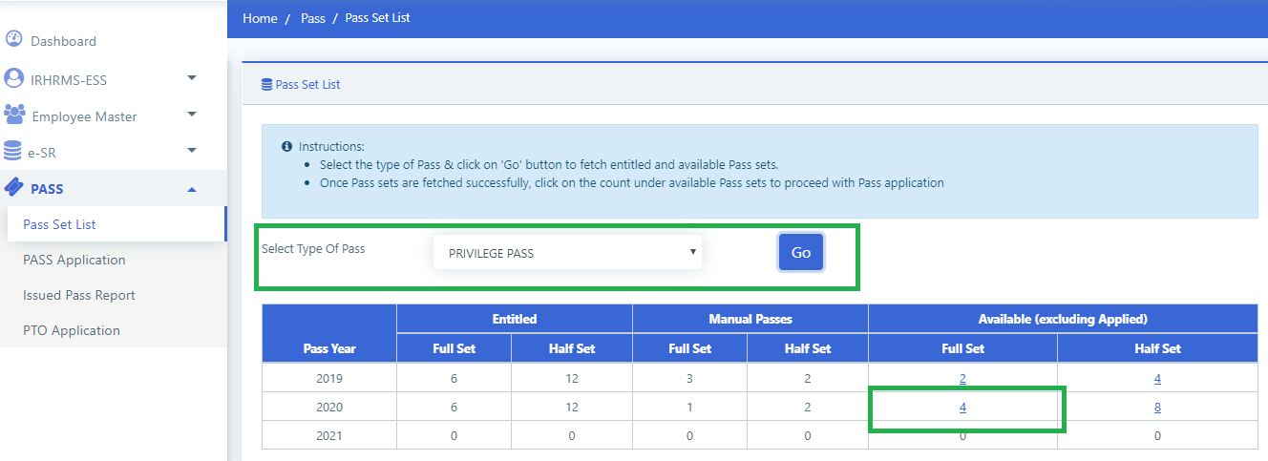
Selecting Pass Type

Slide 16
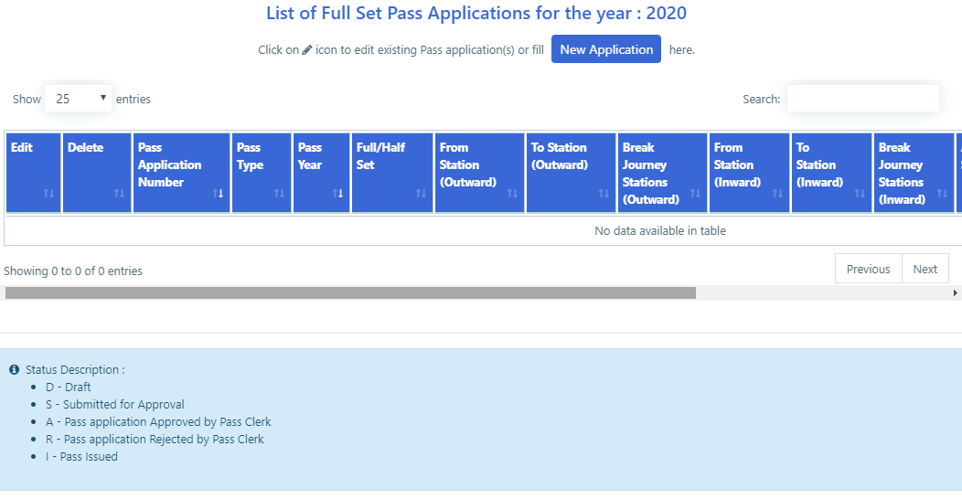
Selecting Pass Application

Slide 17
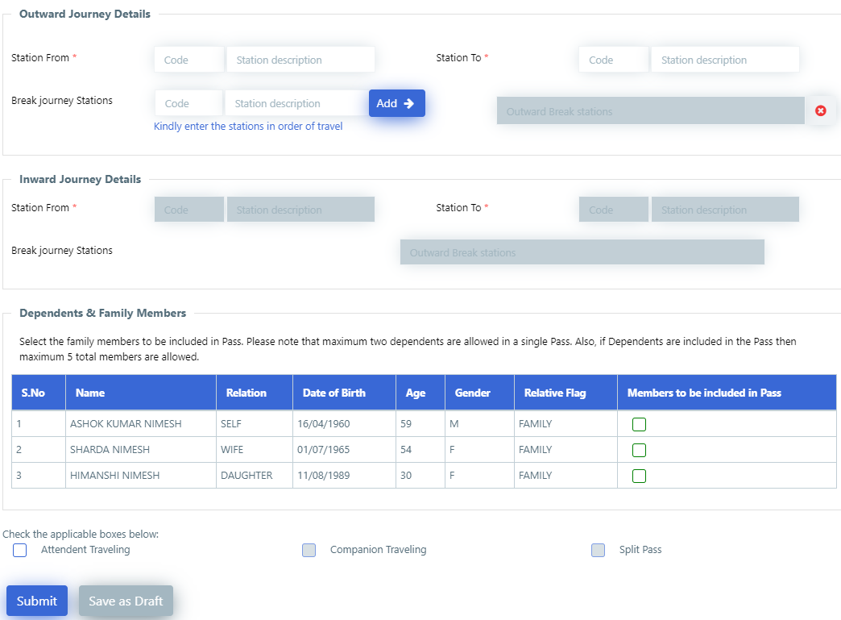
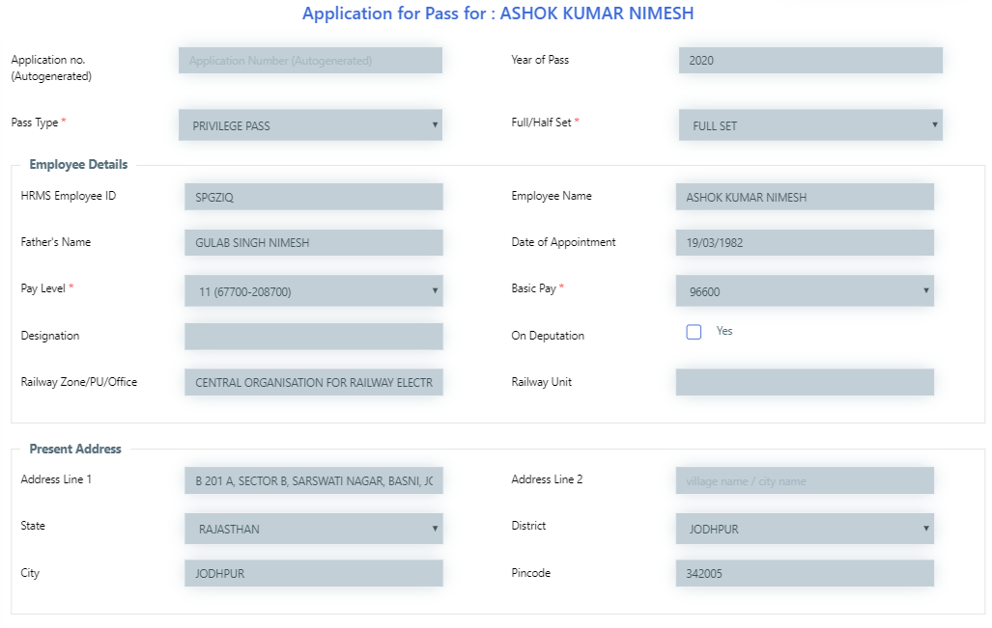
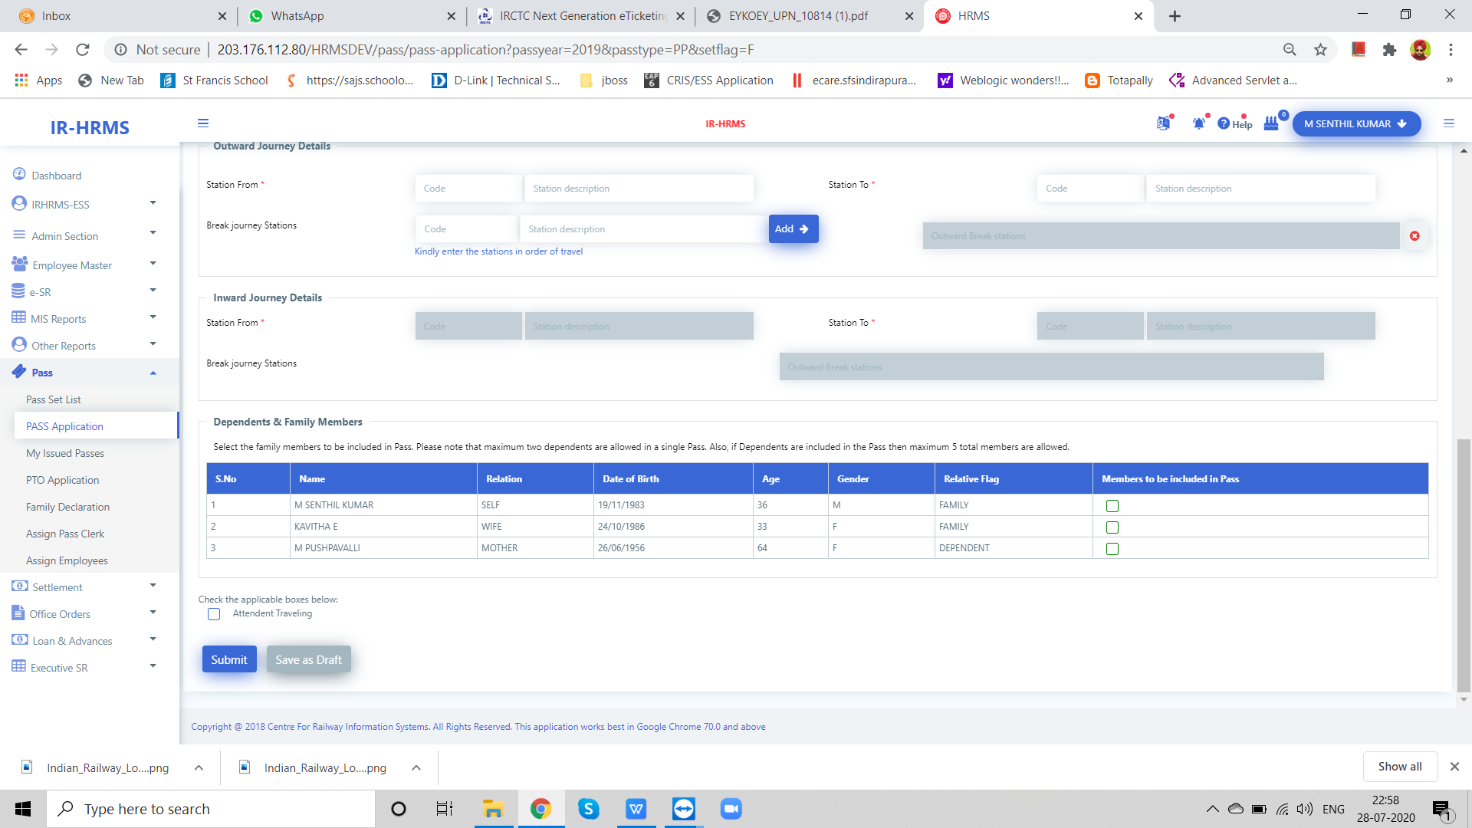
Pass Application

Slide 18
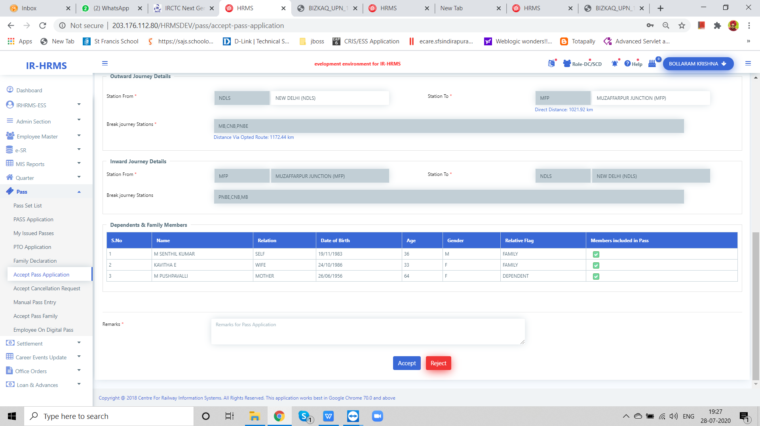
Accept Pass Application by Pass Clerk

Slide 19
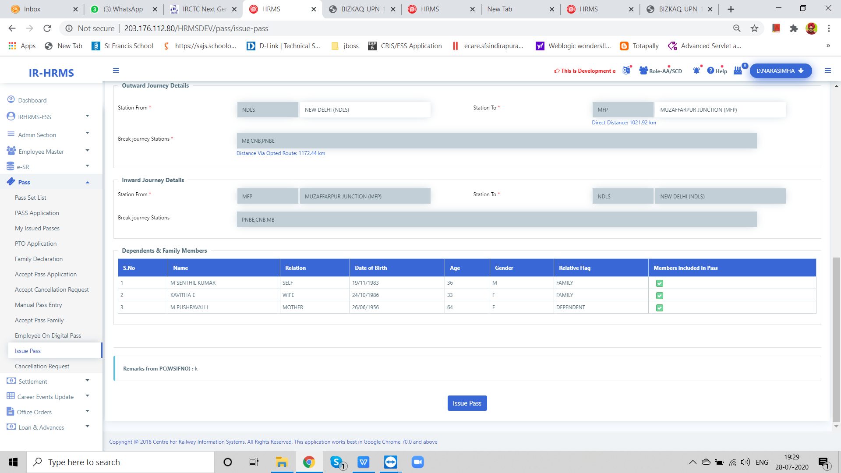
Issue Pass by PIA

Slide 20
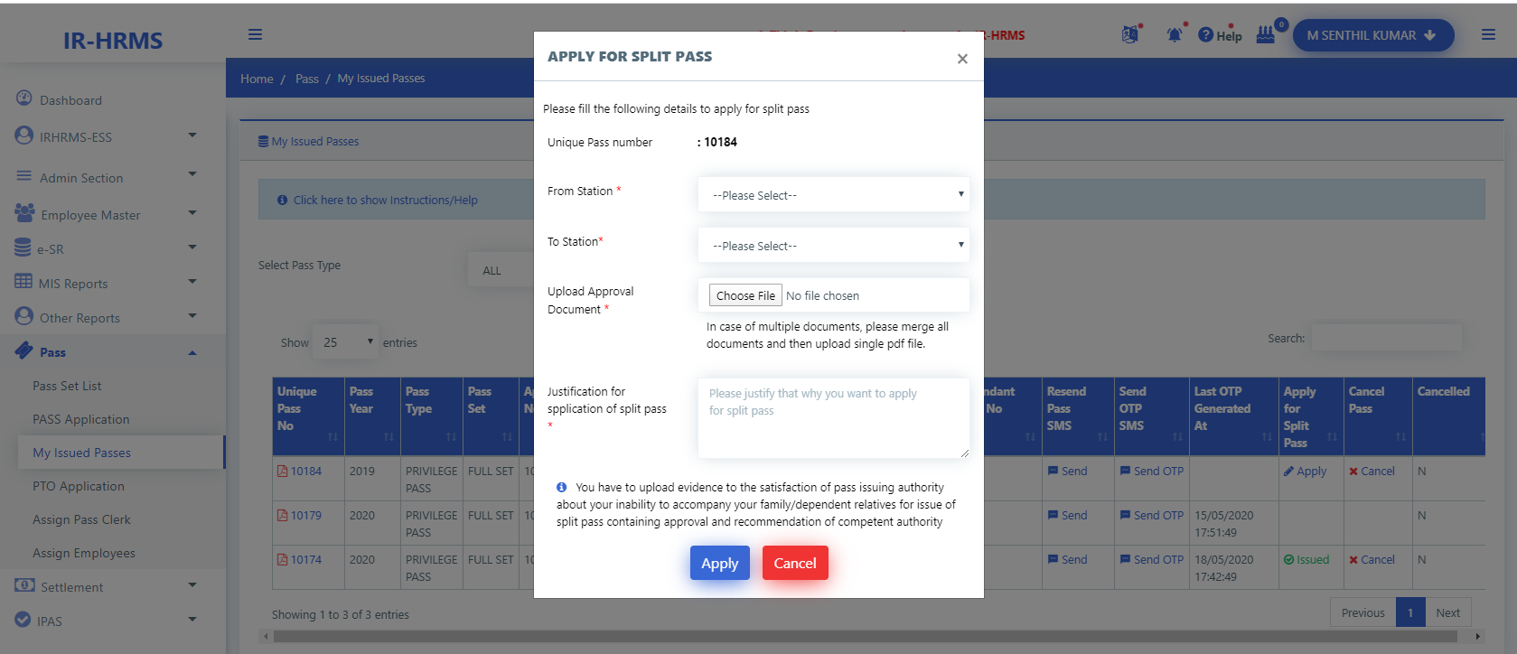
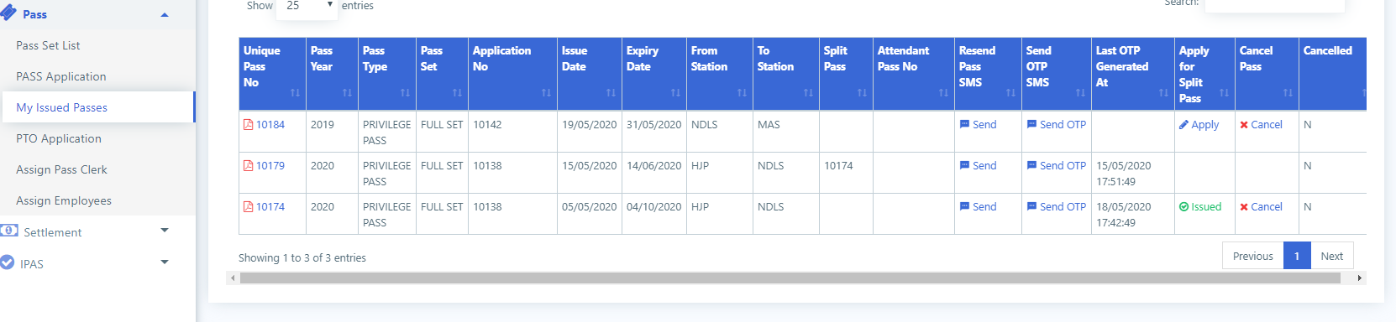
Apply for Split Pass by Employee

Slide 21
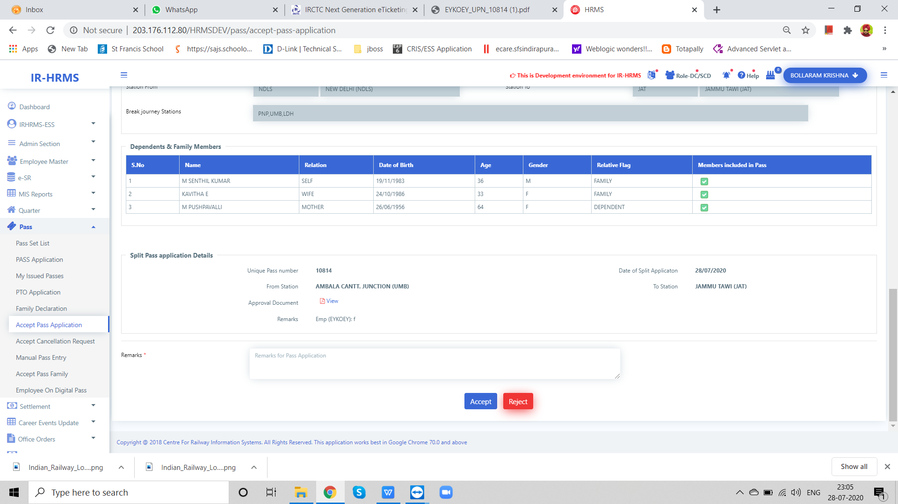
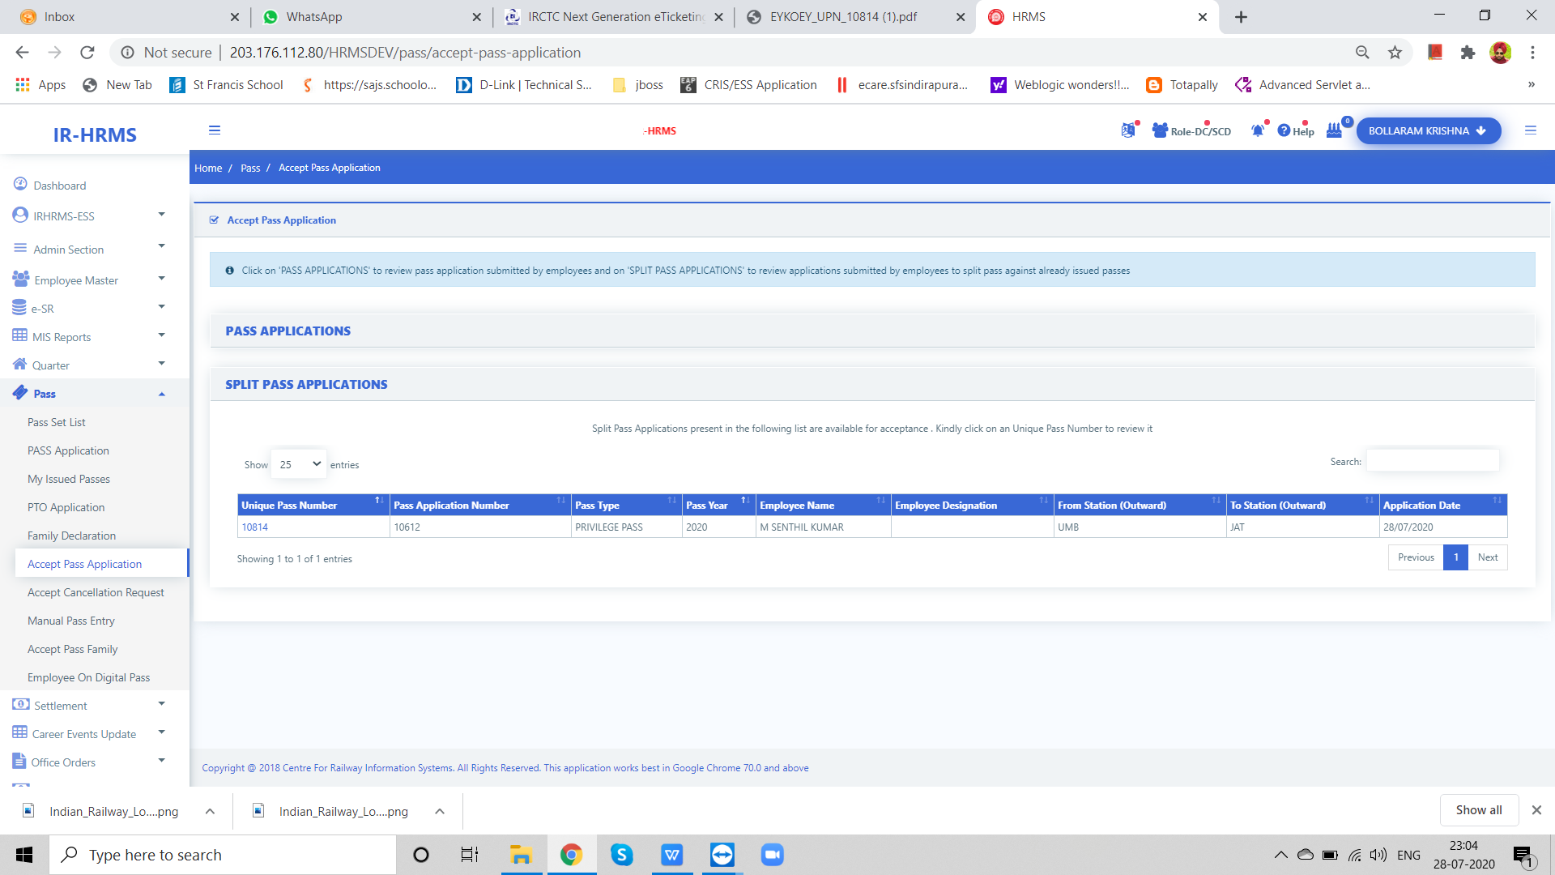
Accept Split Pass by Pass Clerk

Slide 22
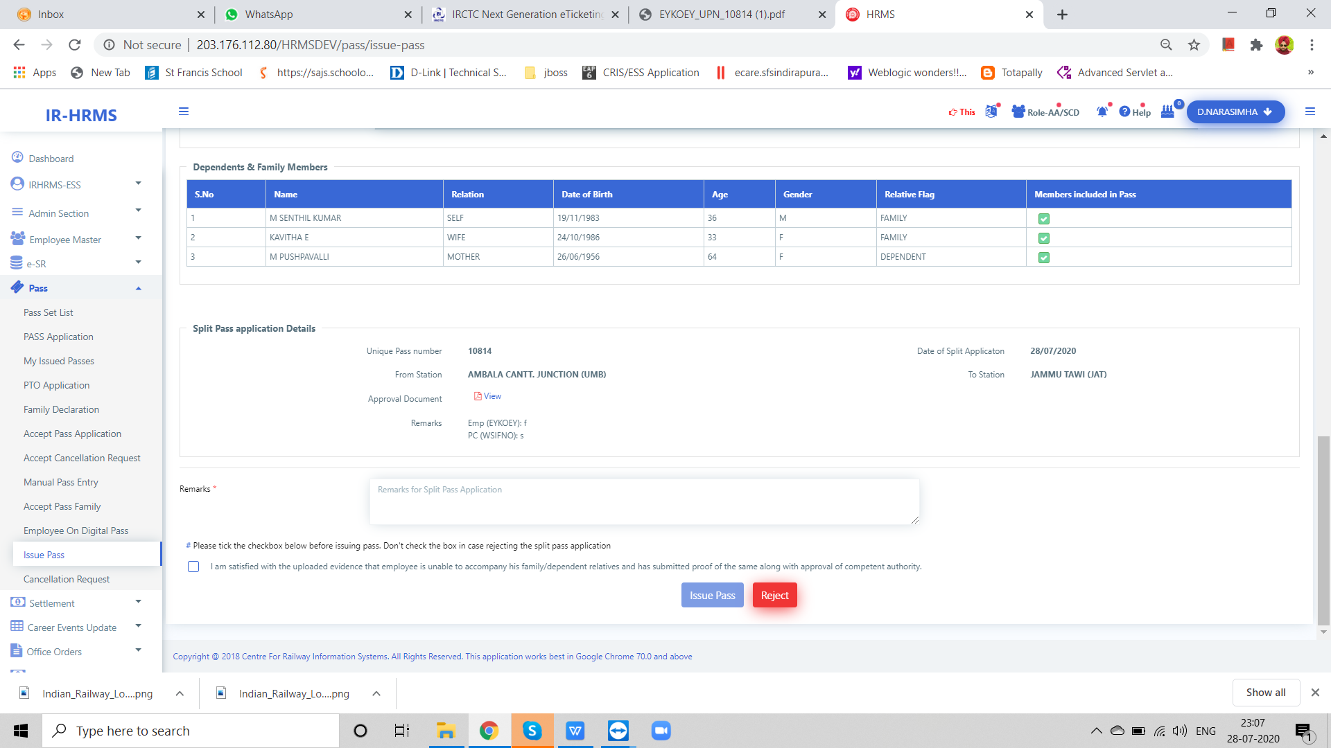
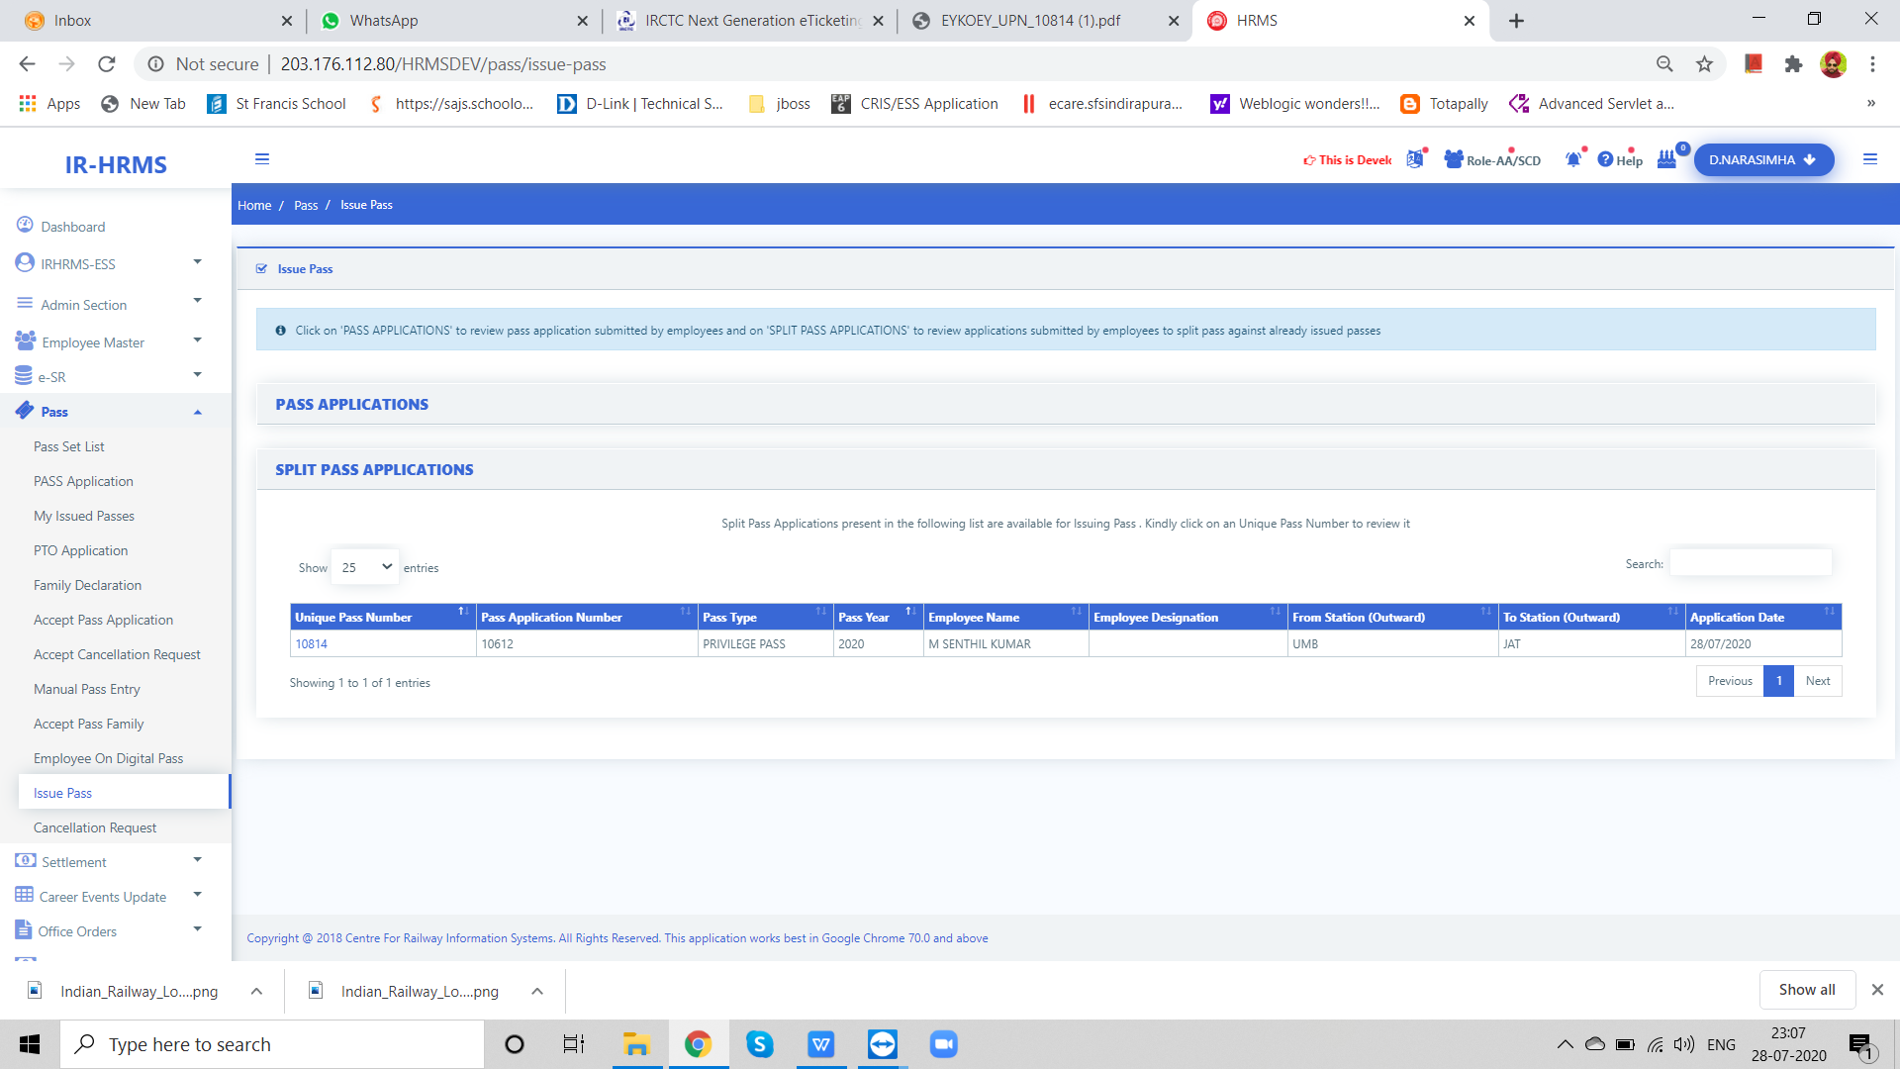
Issue Split Pass by PIA

Slide 23
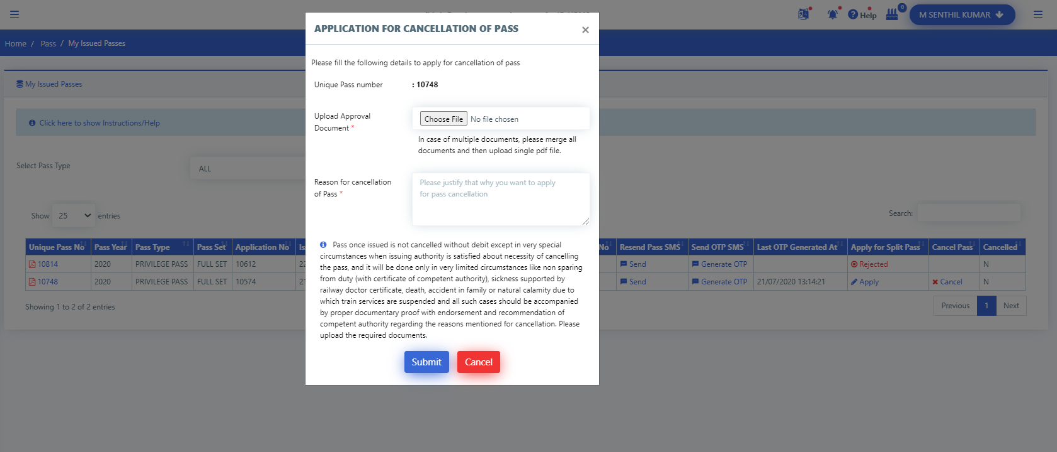
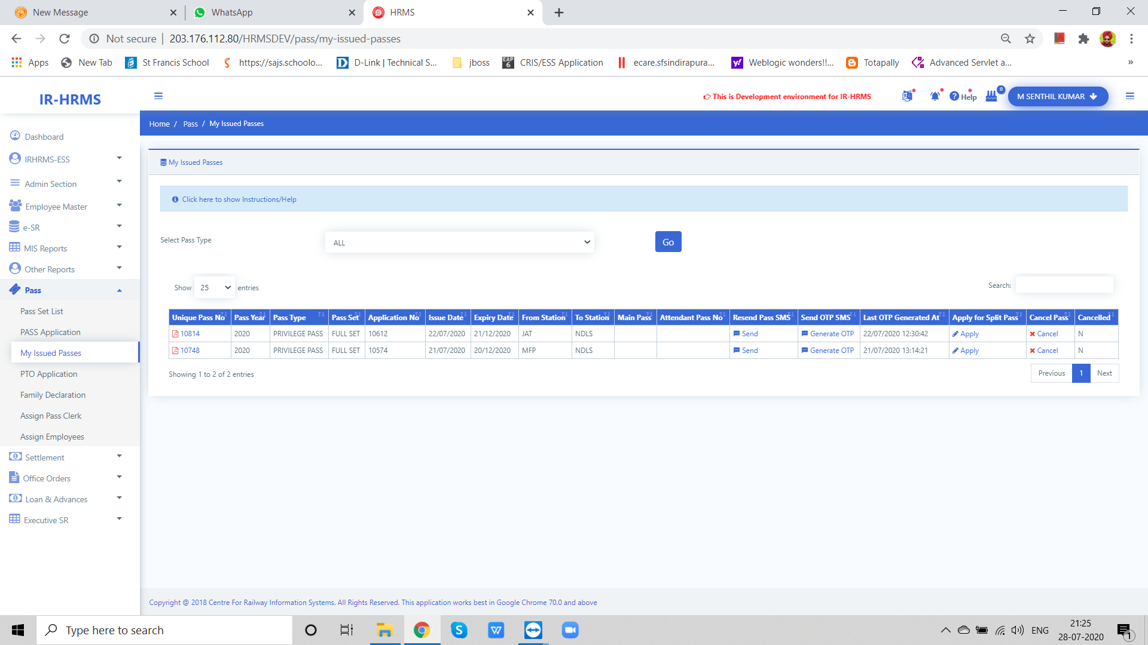
Pass Cancellation Request

Slide 24
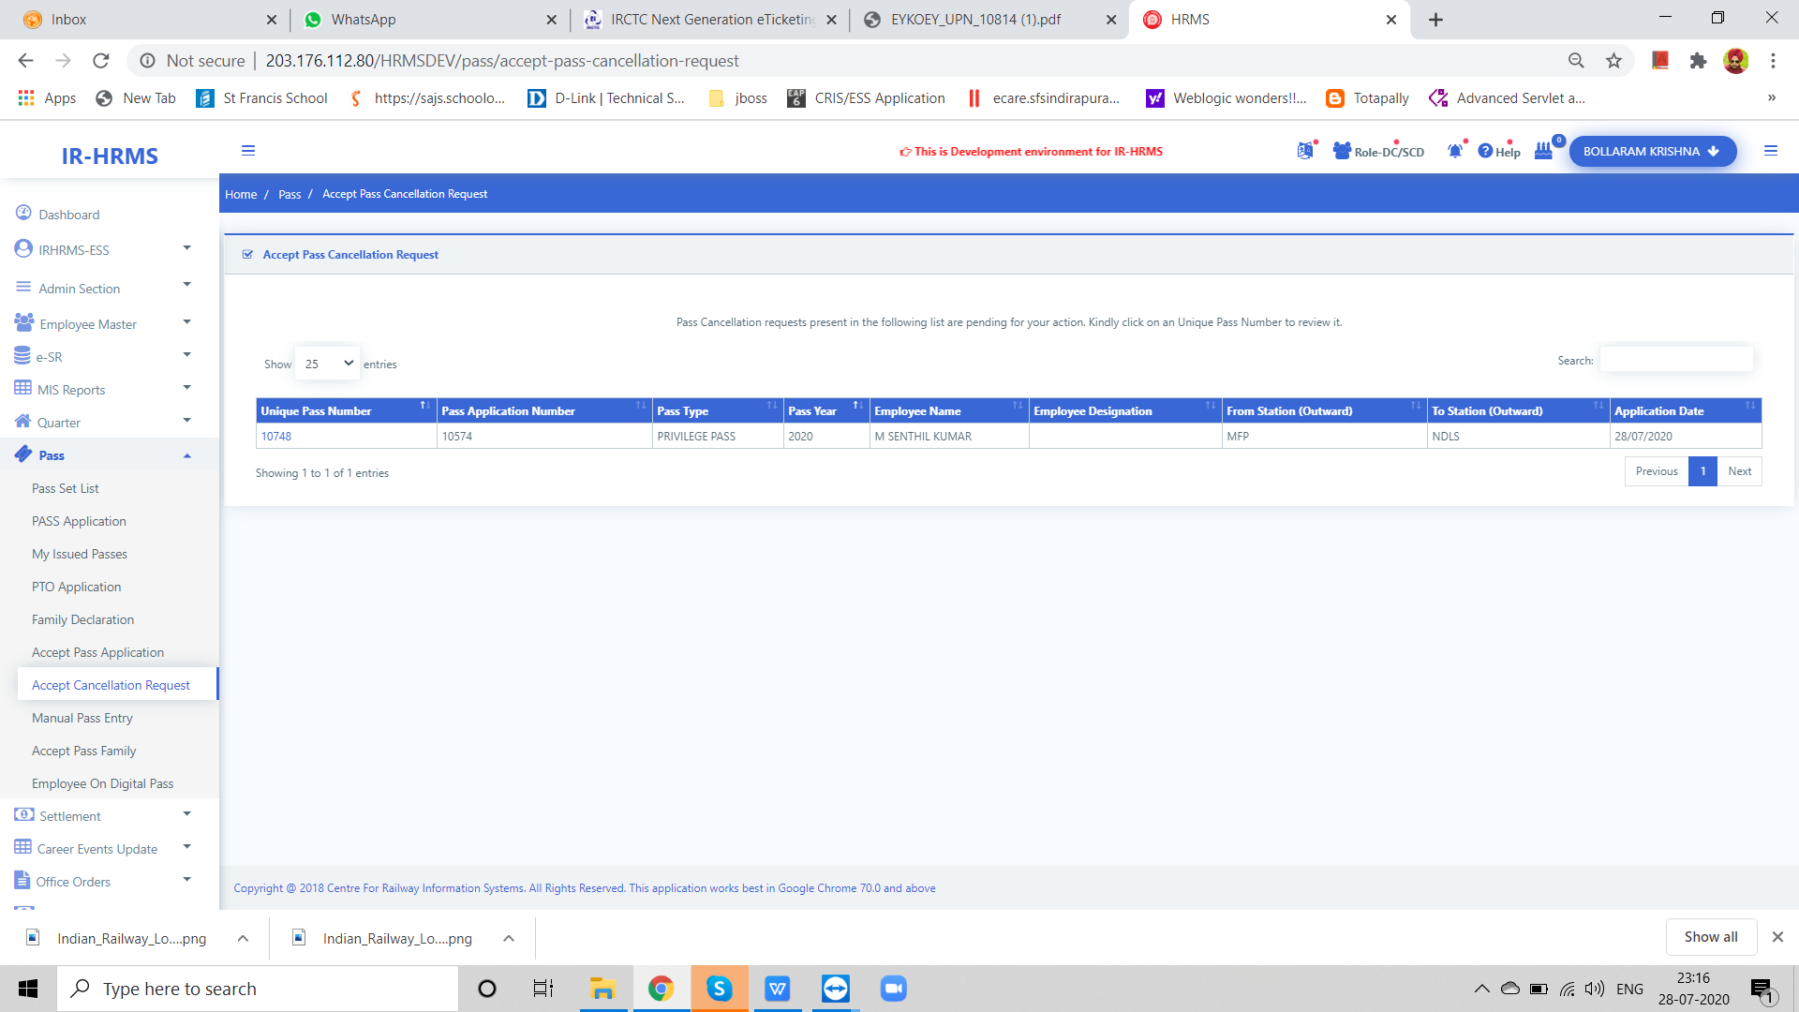
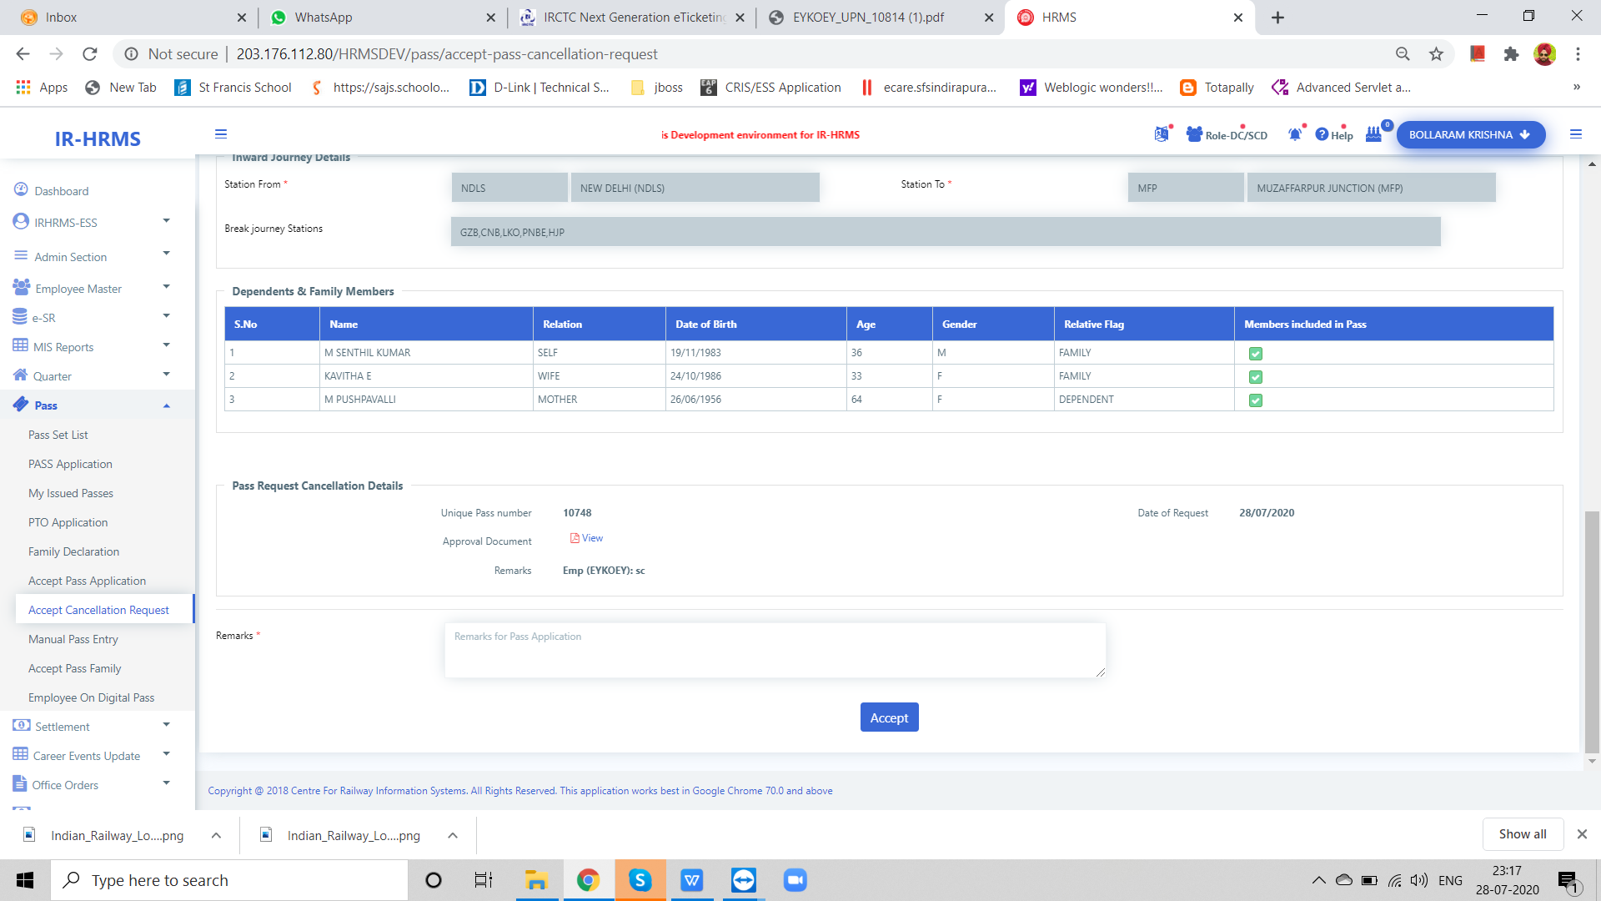
Acceptence/Rejection of Pass Cancellation Request

Slide 25
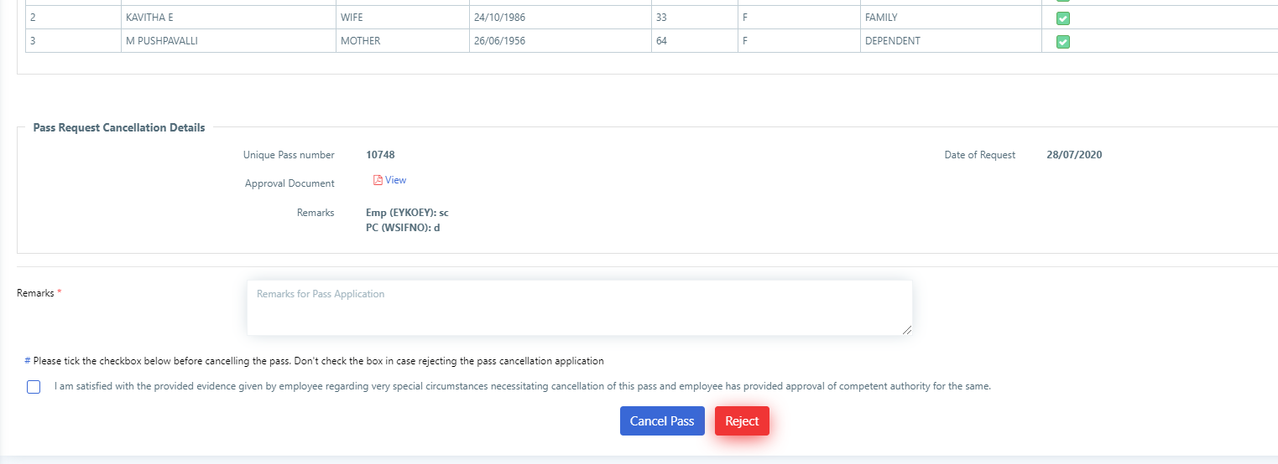
Pass Cancellation By PIA

Slide 26
OTP for Ticket Booking

Slide 27
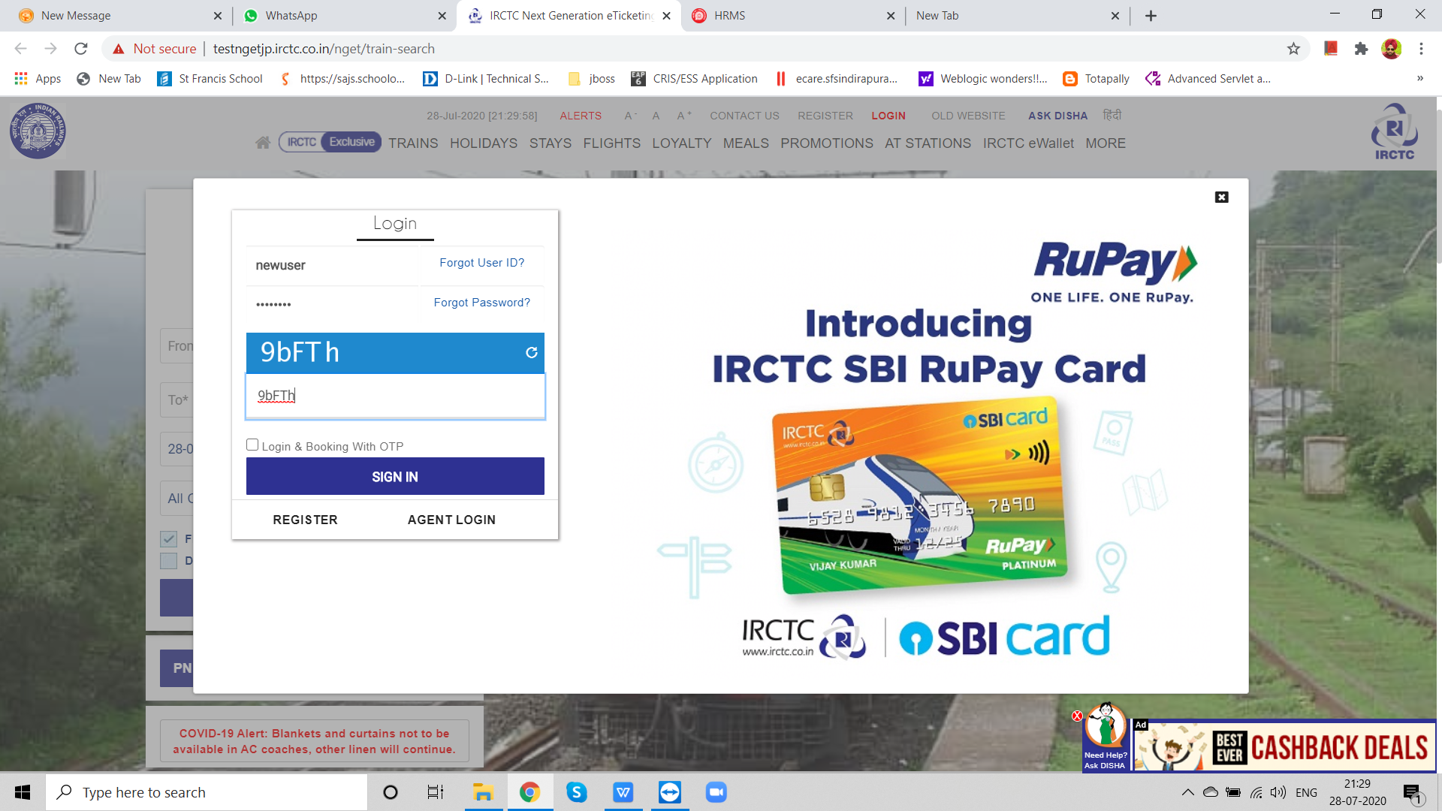
IRCTC Login

Slide 28
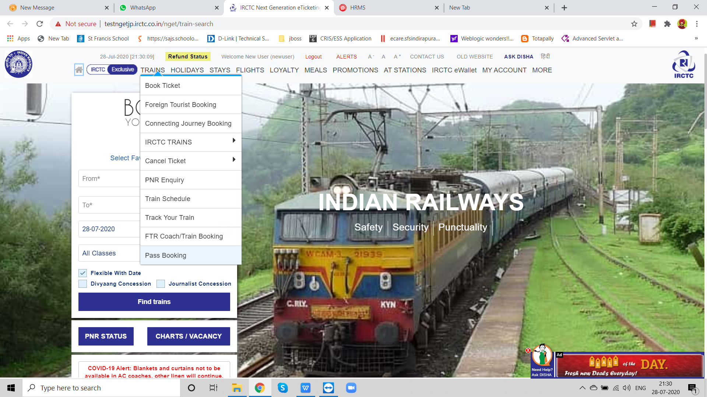
e-Pass Booking Option

Slide 29
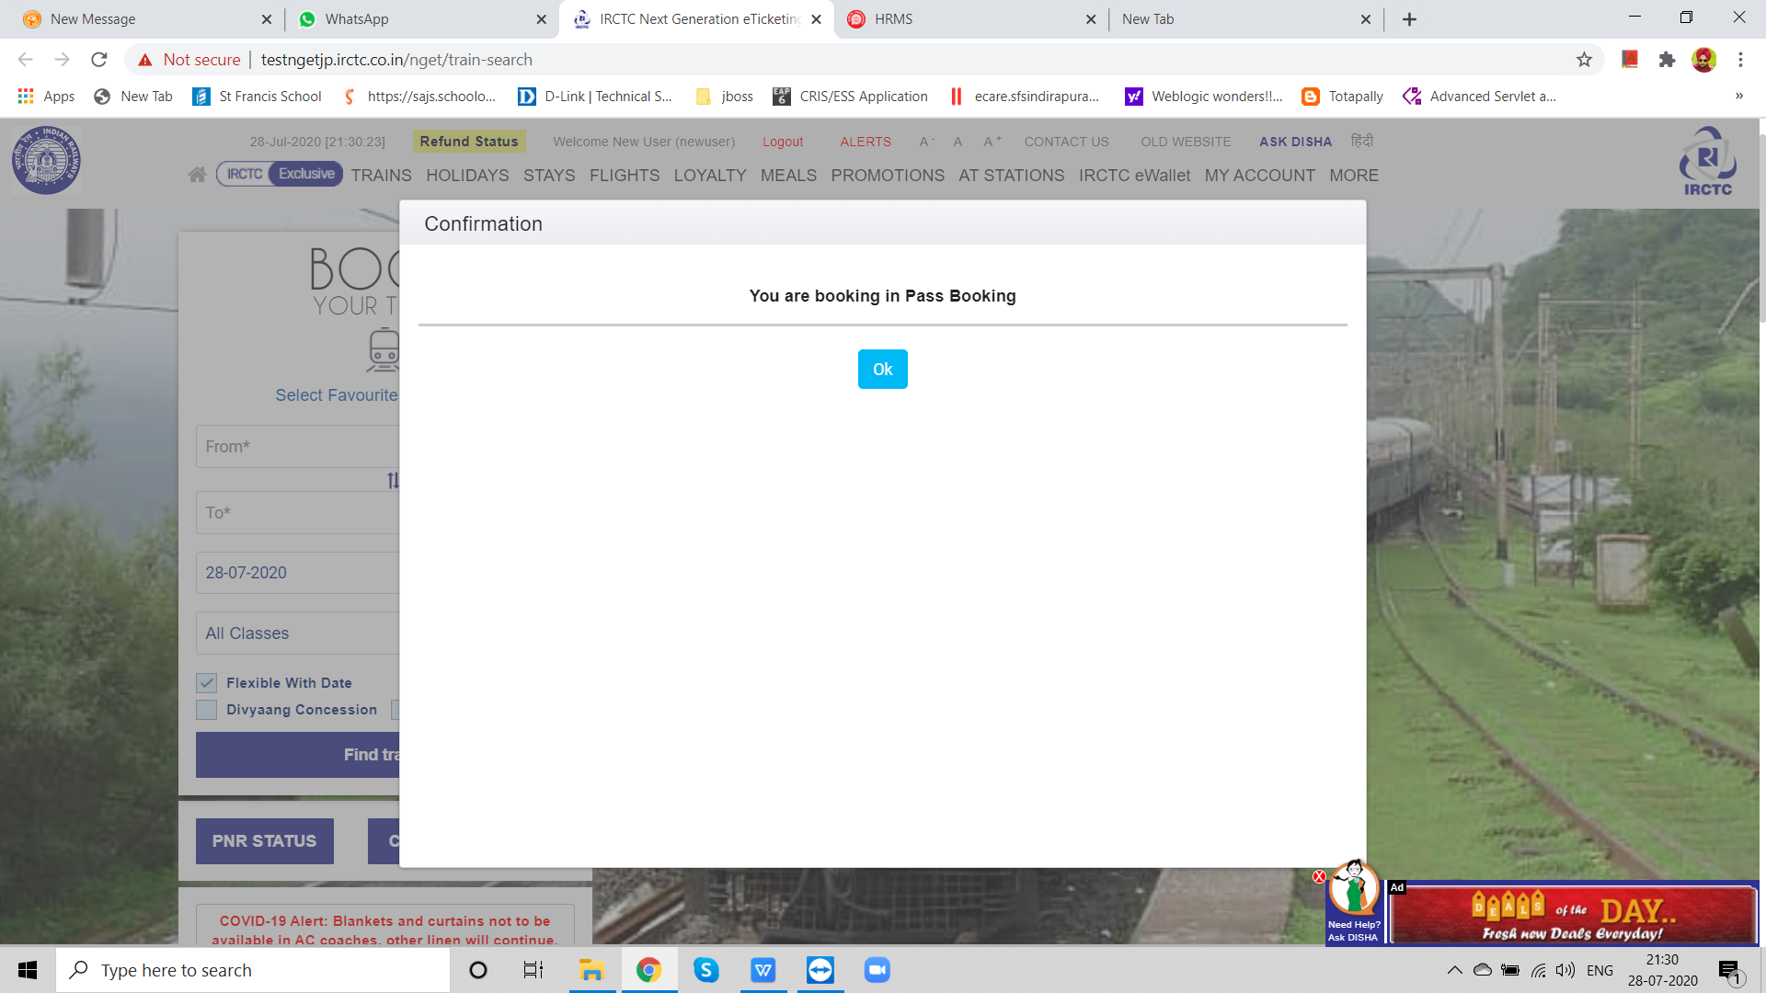
e-Pass Booking Comfirmation

Slide 30
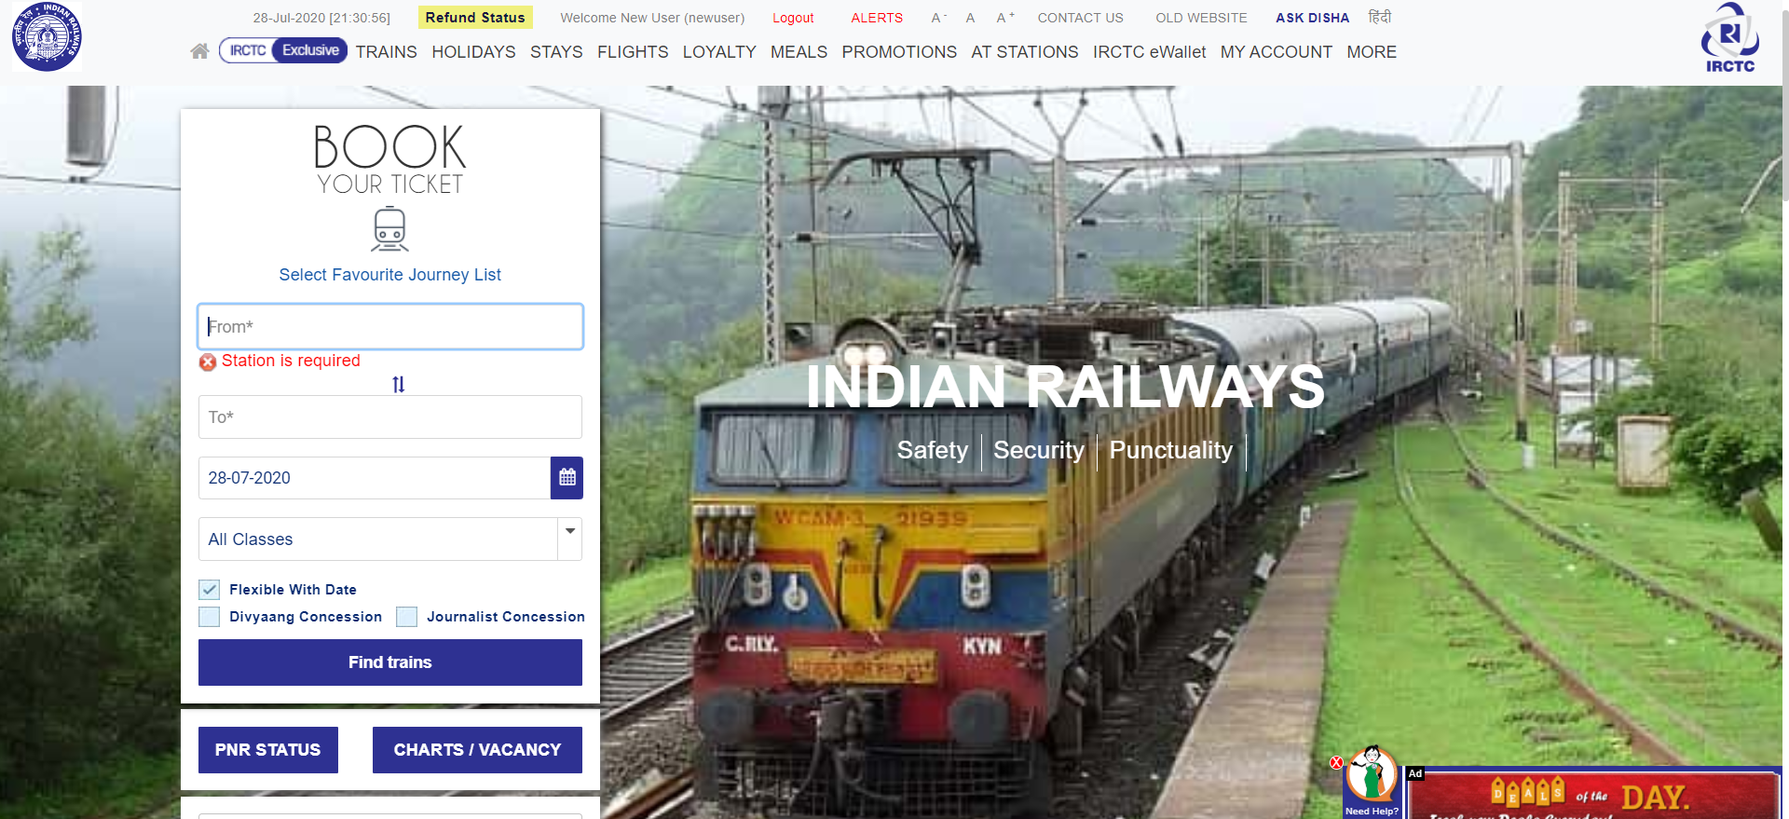
From &To Station Selection

Slide 31
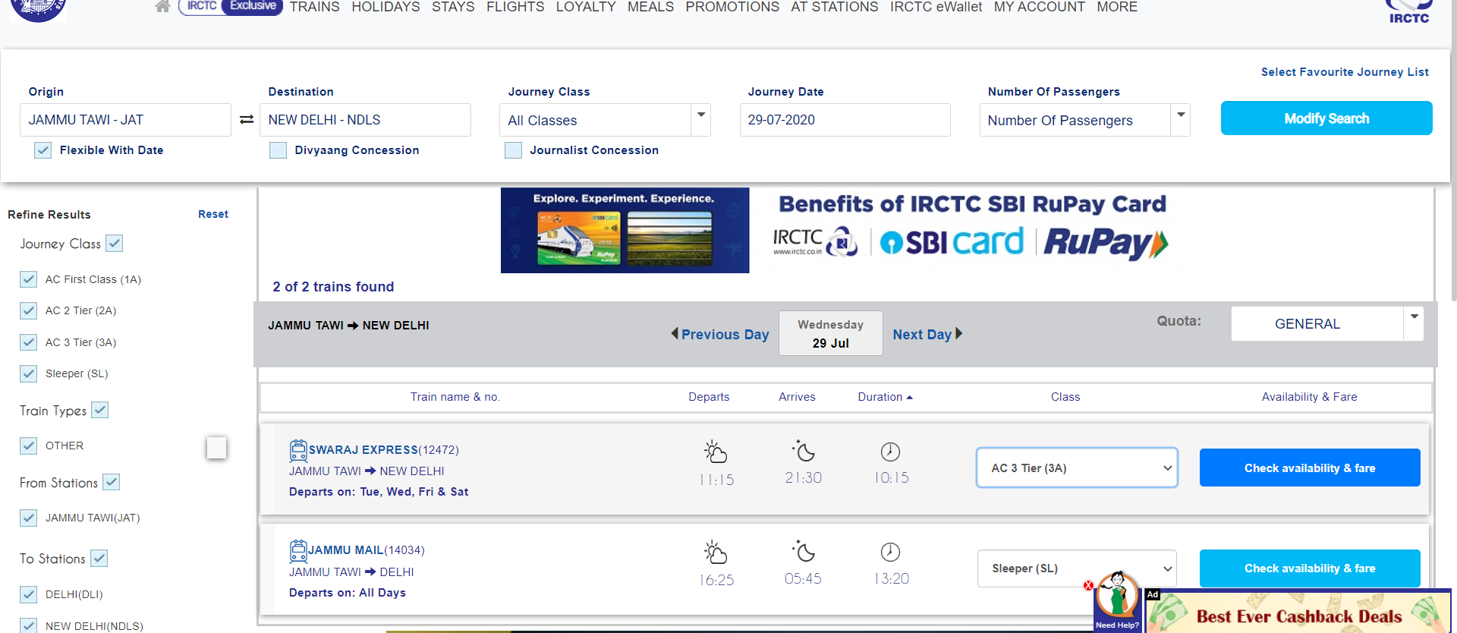
Train and Berth Class Selection

Slide 32
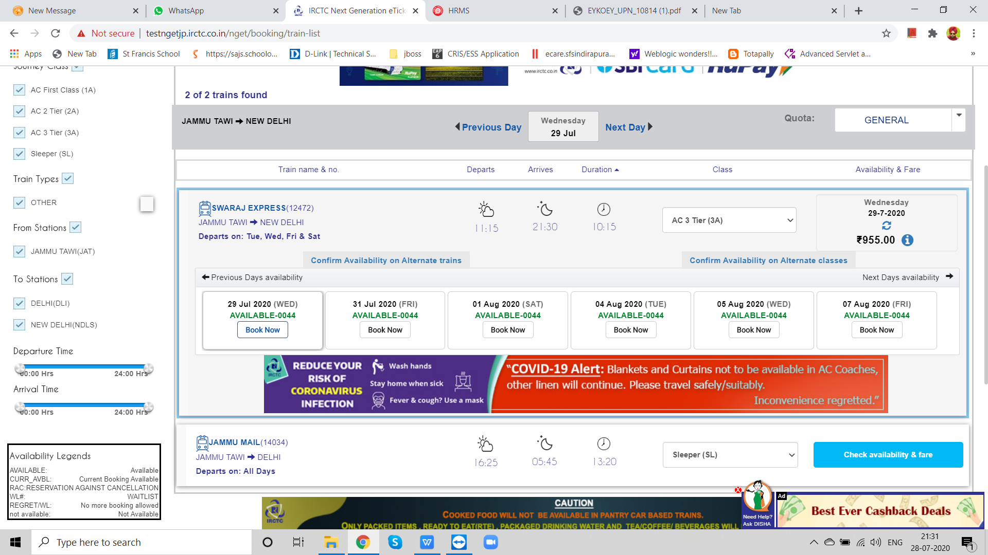
Journey Date Selection

Slide 33
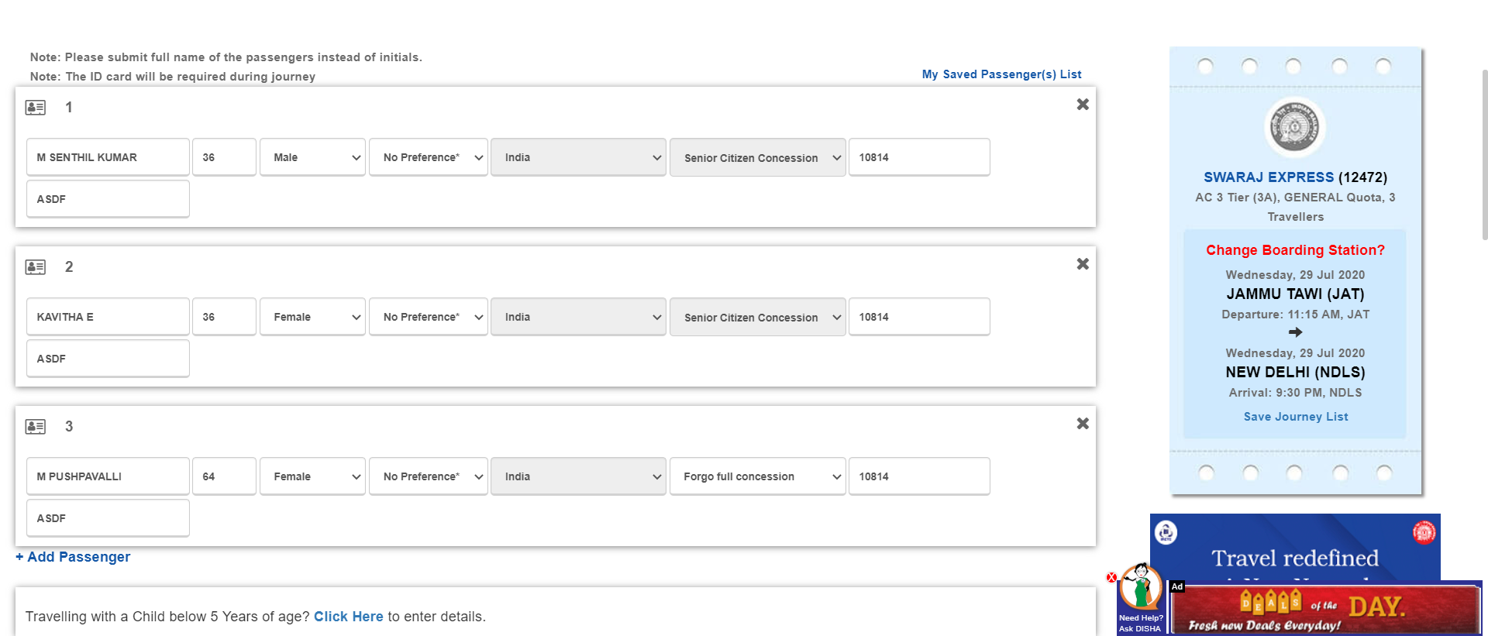
Passenger and e-Pass Details

Slide 34
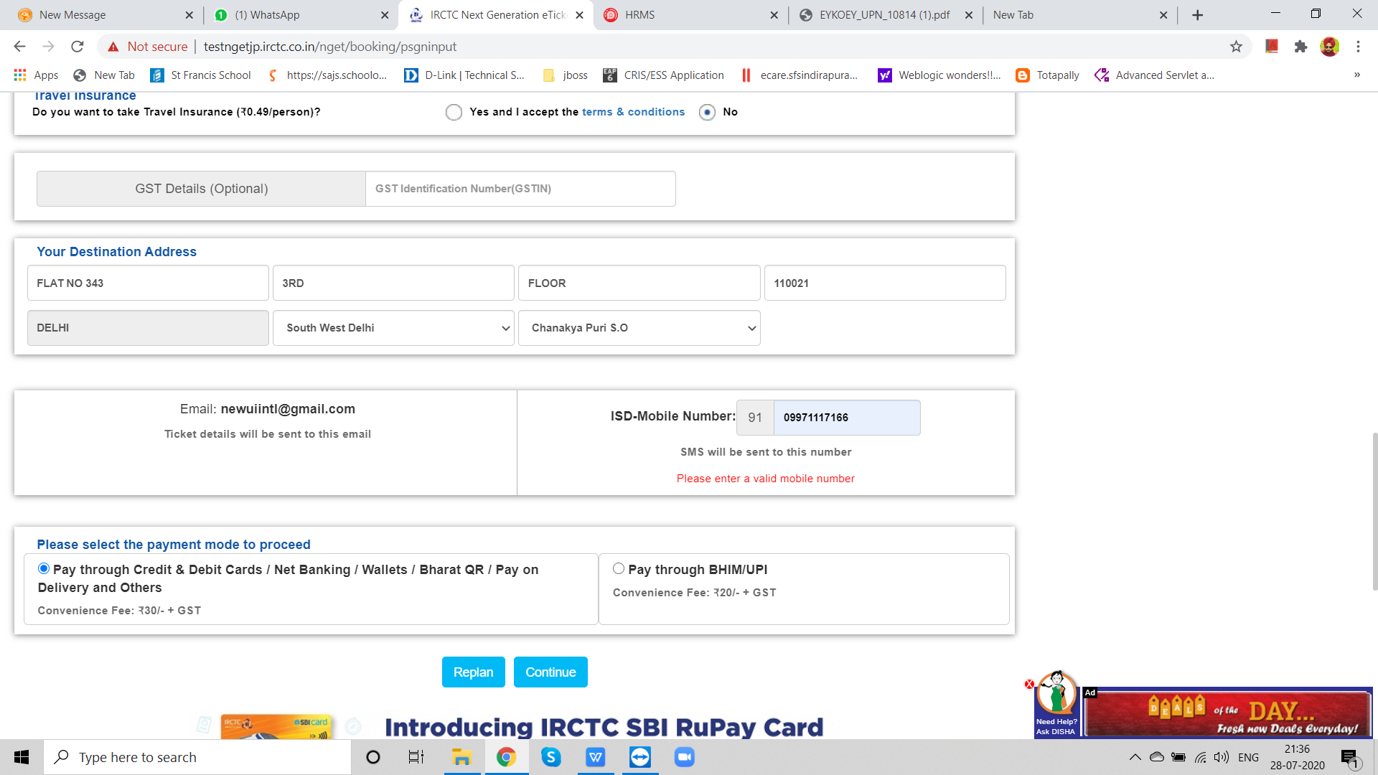
Mobile Number and Address

Slide 35
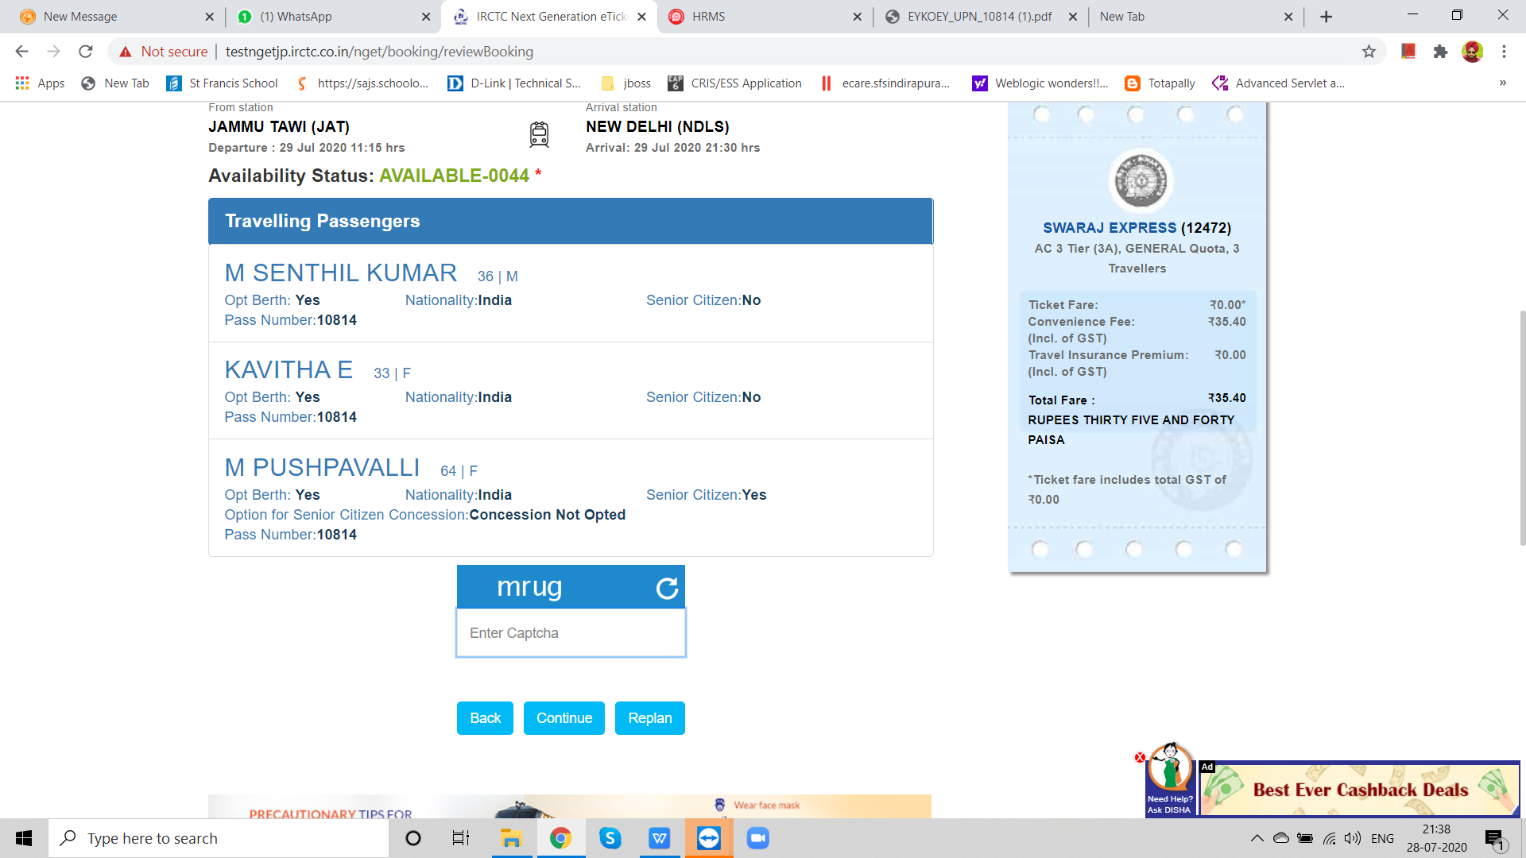
Passenger Detail Confirmation

Slide 36
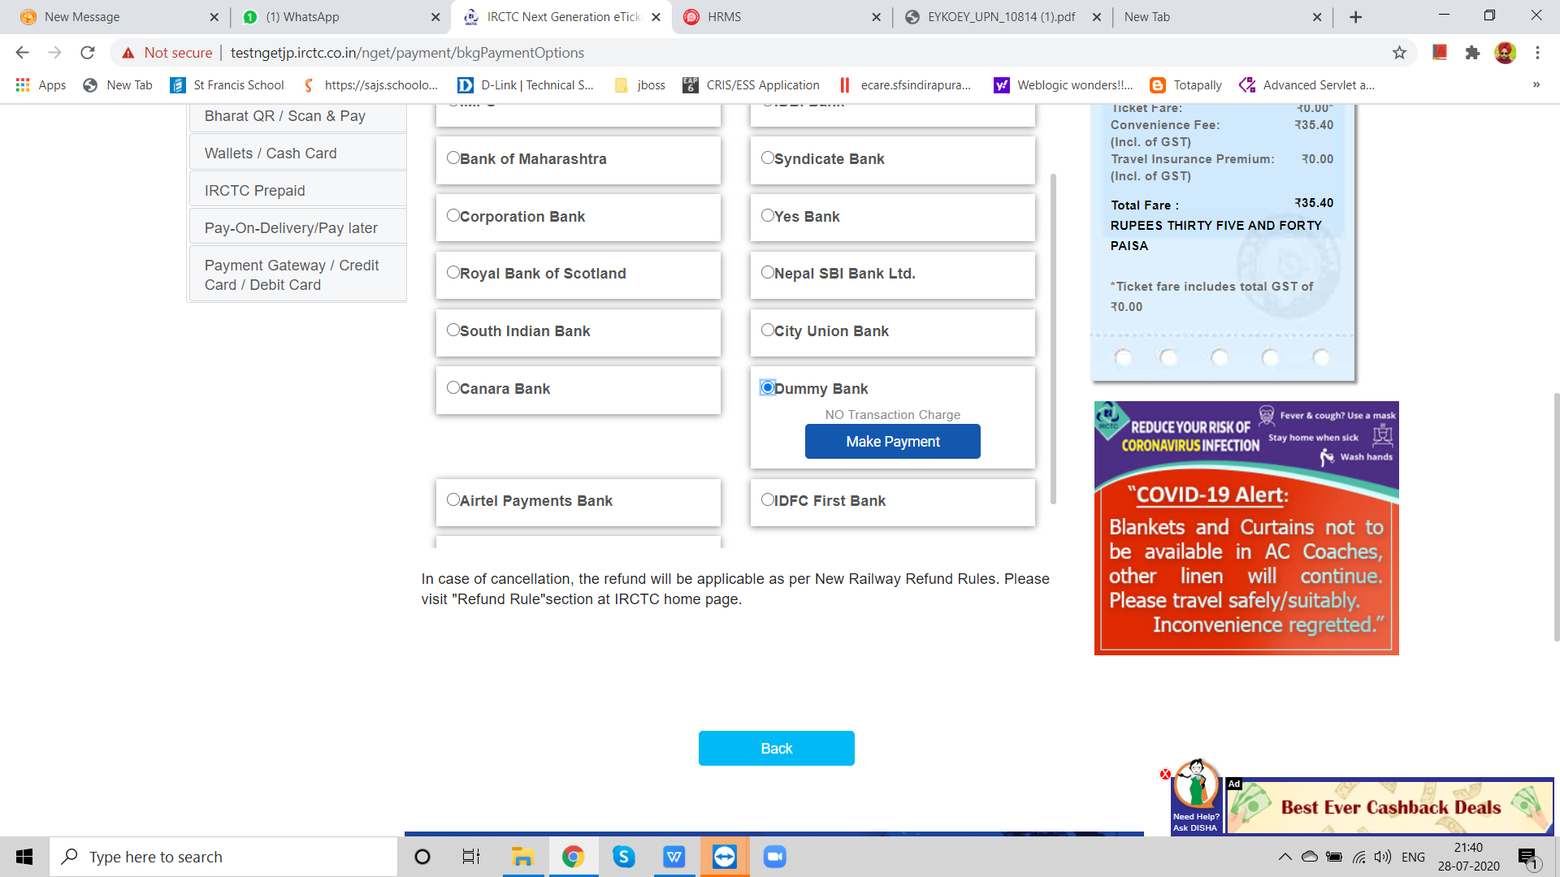
Payment Mode

Slide 37
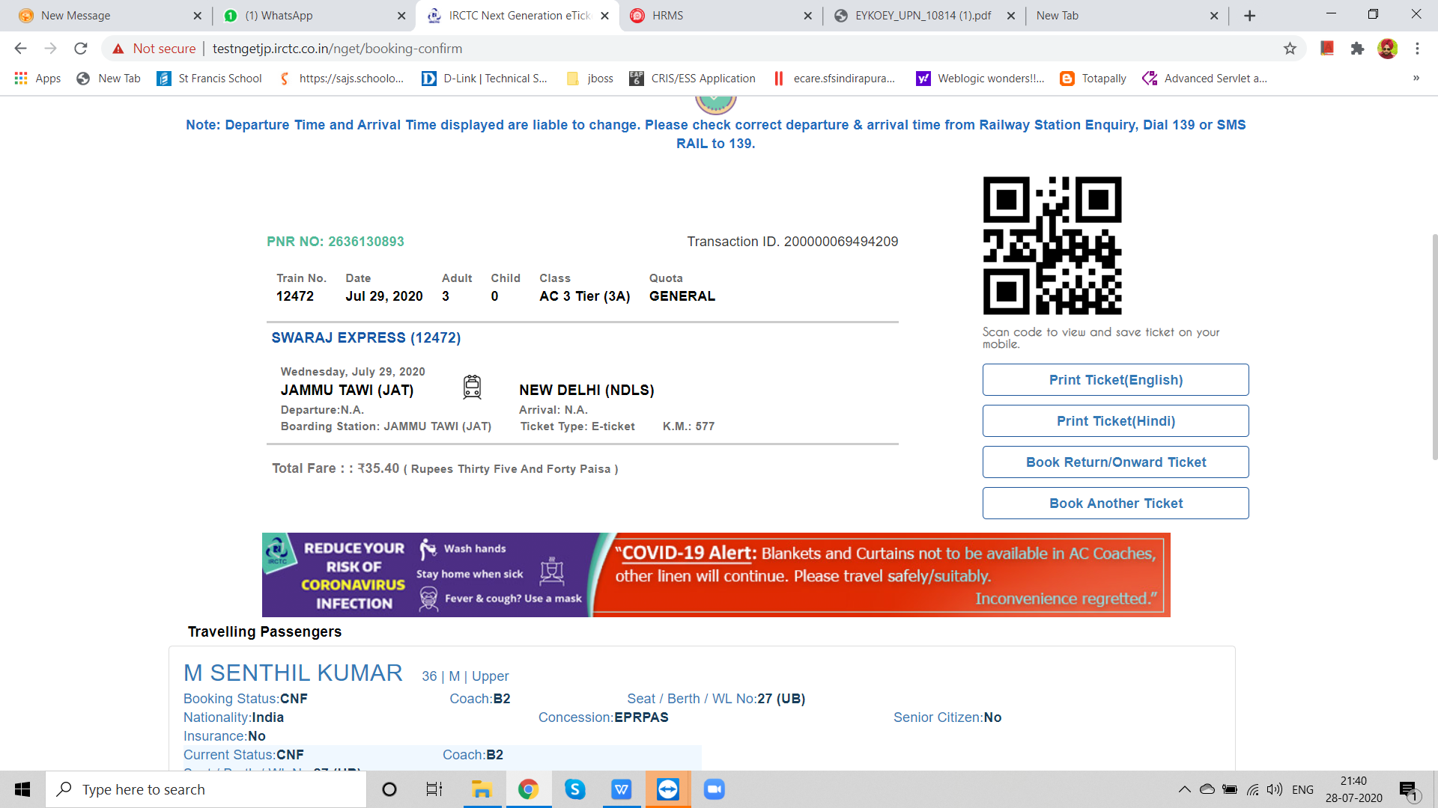
Booked Ticket PNR Detail

Slide 38
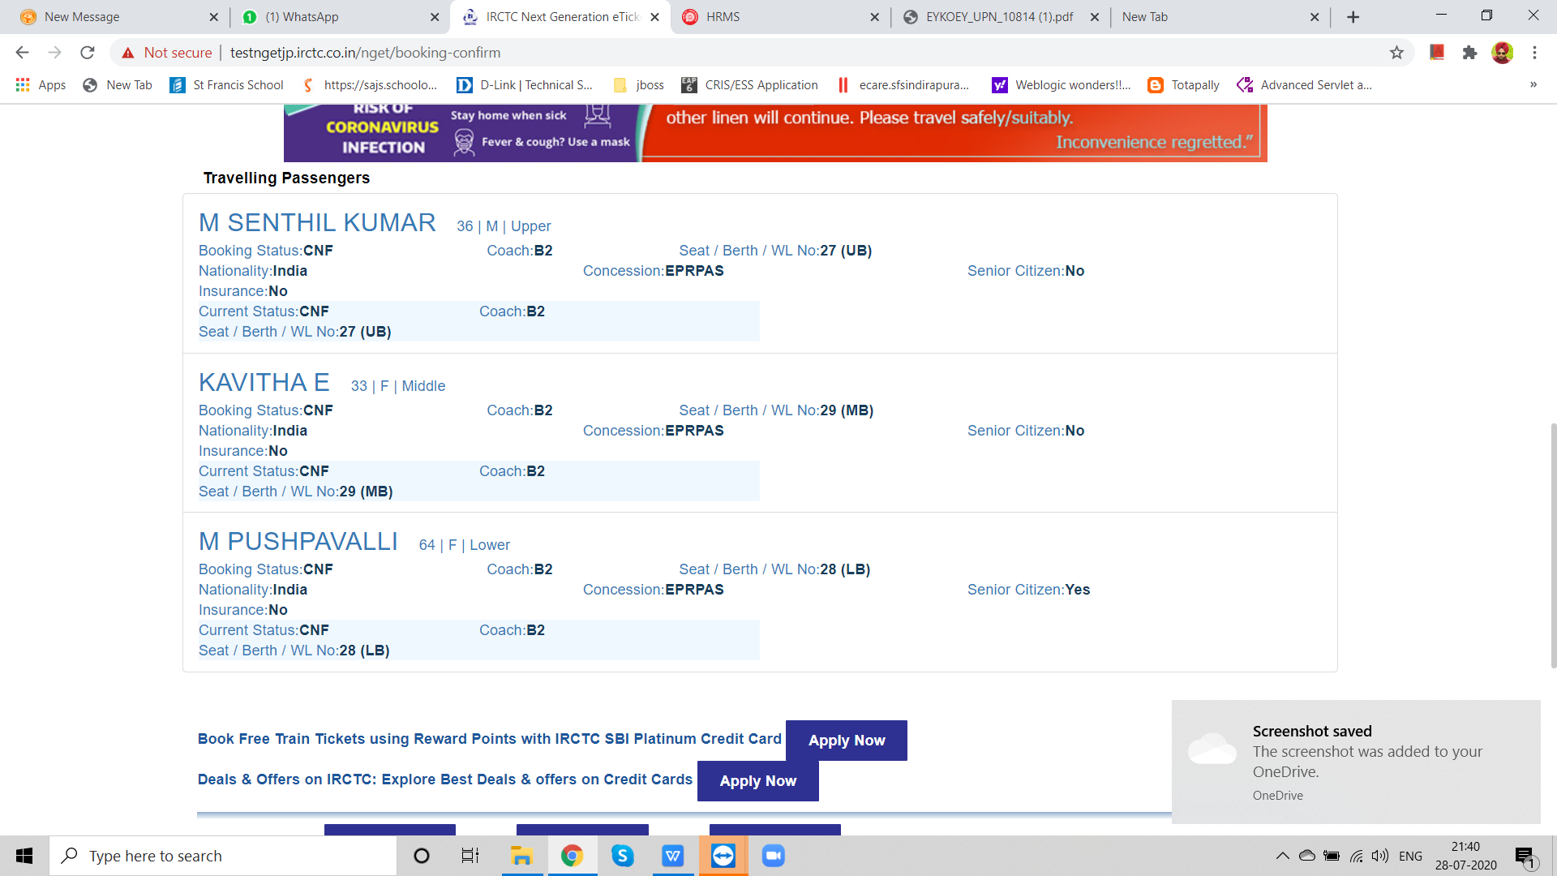
Booked Ticketed Passengers Detail

Slide 39
Thank You

